Slide 1








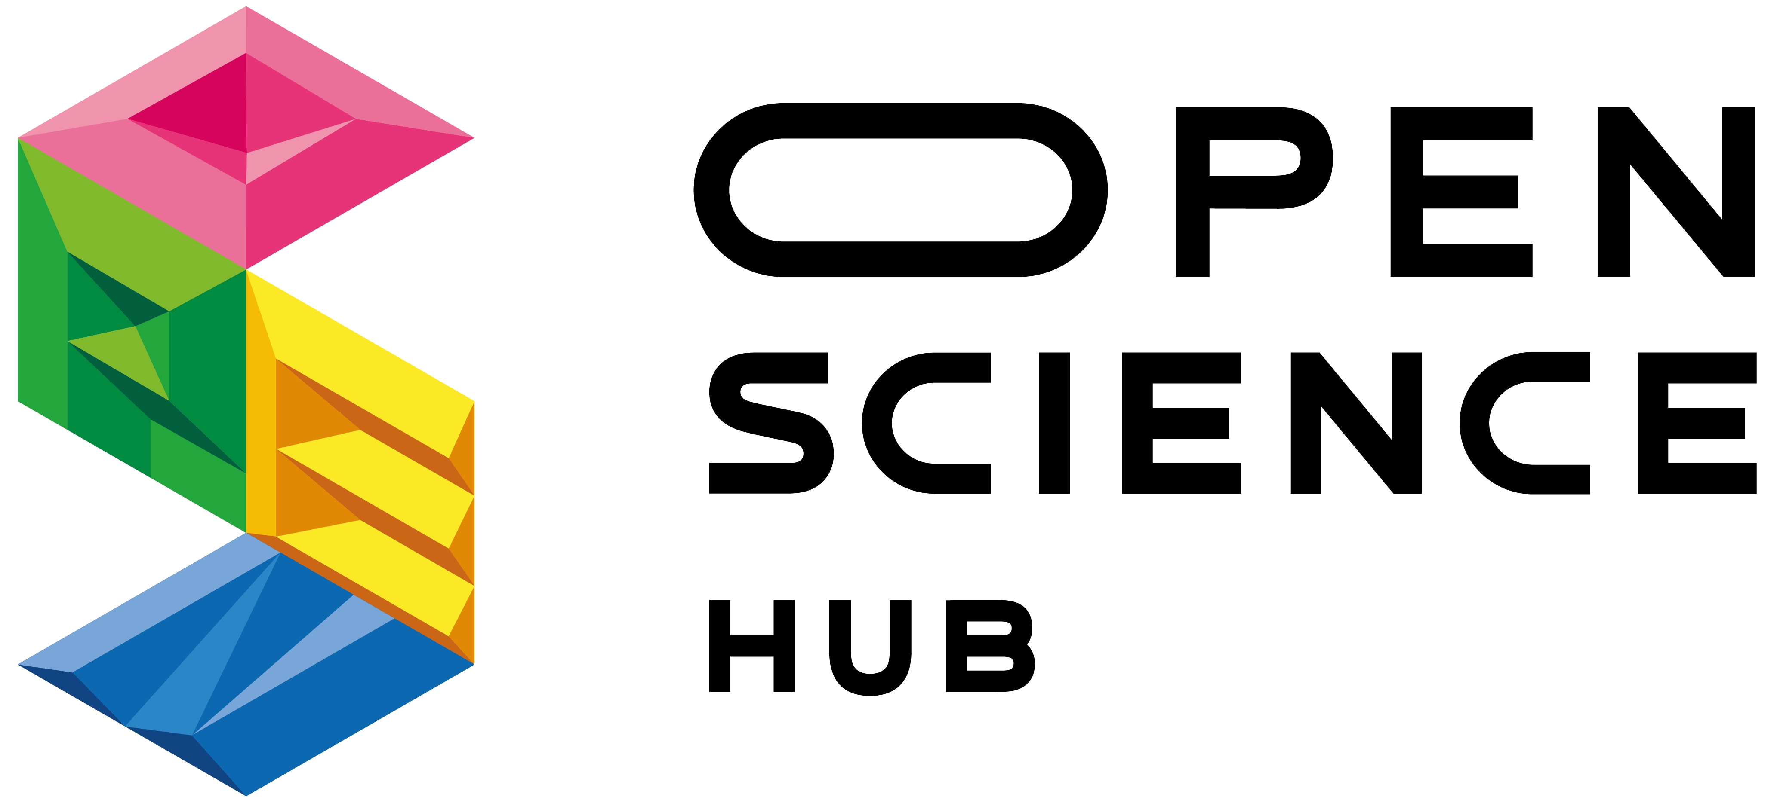
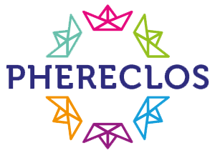


Evaluation approaches for measuring the impact of open schooling
Students learn with real-life projects supported by teachers, families/communities and professionals
Ale Okada (Org.)
Notes:
“Open schooling refers to schools, in cooperation with other stakeholders, become agents of community well-being; families are encouraged to become real partners in school life and activities; professionals from enterprise, civil and wider society are actively involved in bringing real-life projects into the classroom.”

Slide 2
Evaluation approaches for measuring the impact of open schooling (OS)
Objectives
Identify potential collaborations among projects
Brainstorm evidence & strategies to support OS together
Be aware of OS evaluation approaches
Discuss how Policy Makers can be engaged

Slide 3
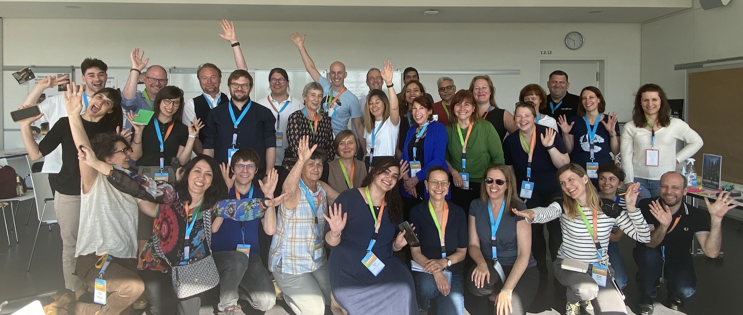
Collaborations among projects
We love open schooling, but…
ECSITE Conference
Hilbronn 1st June 2022

Slide 4
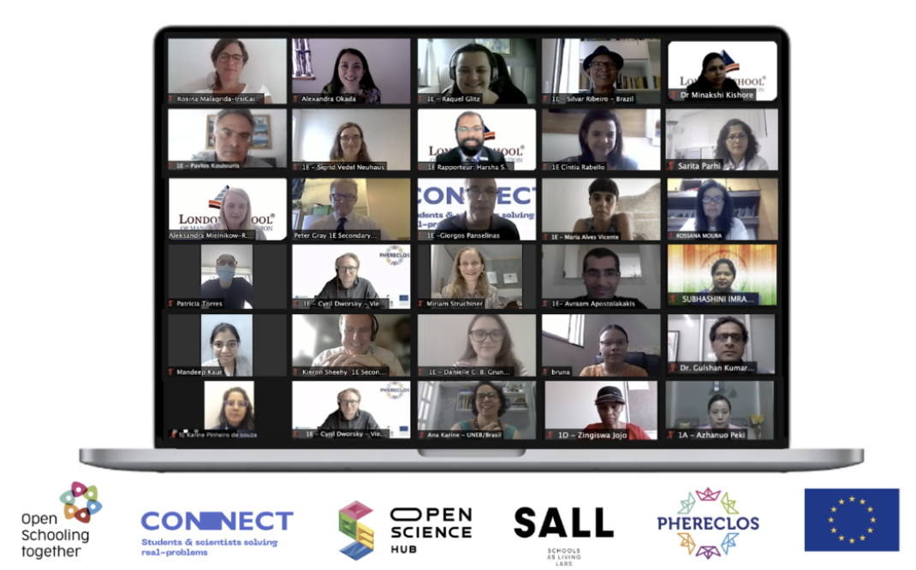

Collaborations among projects
Education for Sustainable Development with Open Schooling
LSME Conference
London Aug 2021/ 2022

Slide 5
Open Schooling Together timeline
Period | Projects websites | Description with EC portal link | Goal
2019-2022 | OSHub | Open science hub network: empowering citizens through steam education with open schooling. | Scientific education of communities for their sustainable development using RRI.
2019-2022 | PULCHRA | Building participatory urban learning community hubs through research and activation. | Strengthening science education through community partnerships "cities as urban ecosystems".
2019-2022 | PHERECLOS | Partnerships for pathways to higher education and science engagement in regional clusters of open schooling. | Engagement of children and young people with academic research.
2019-2022 | SEAS | Science education for action and engagement towards sustainability. | Advancement of scientific literacy for responsible citizenship.
2020-2023 | CONNECT | Inclusive open schooling through engaging and future-oriented science. | Formal and informal education with science action in the curriculum and fun participatory approaches.
2020-2023 | MOST | Meaningful open schooling connects schools to communities. | Partnerships to promote scientific competencies with community projects from the environmental school.
2020-2023 | Make it Open | Make it open. | Opening up of school learning through maker education.
2020-2023 | SALL | Schools as living labs. | Research and demonstration projects in outdoor spaces in food for sustainability contexts.
2021-2024 | COSMOS | Creating organisational structures for meaningful science education through open schooling for all | Creation of communities of practice (COP) on relevant socio-scientific issues.
2021-2024 | MultiPlayers | Multiplayers' partnerships to ensure meaningful engagement with science and research. | Open scientific communities with open community events for data collection and decision-making processes.
2021-2024 | Pafse | Partnerships for science education. | Preparing communities to reduce the risk of communicable diseases and epidemics.
G1. in completion
G2. in development
G2.beginners
Source: Okada et. al.(2022 in development) LSME Conference Global Education for Green Economy

Slide 6
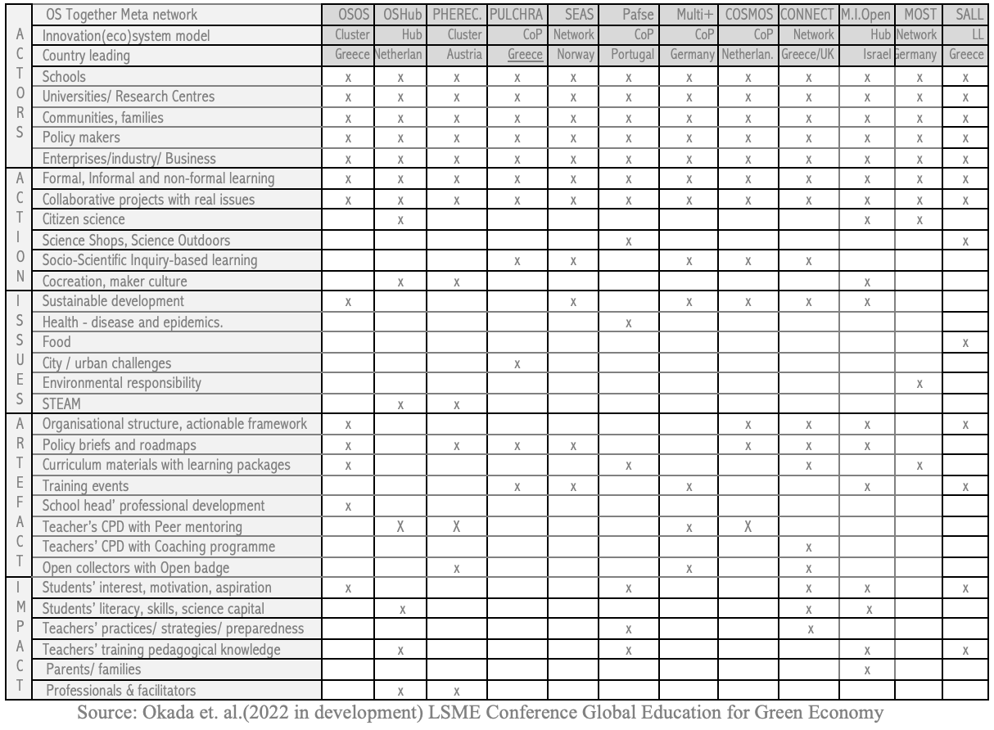
Open Schooling Together Innovation Ecosystems supported by evaluation

Slide 7
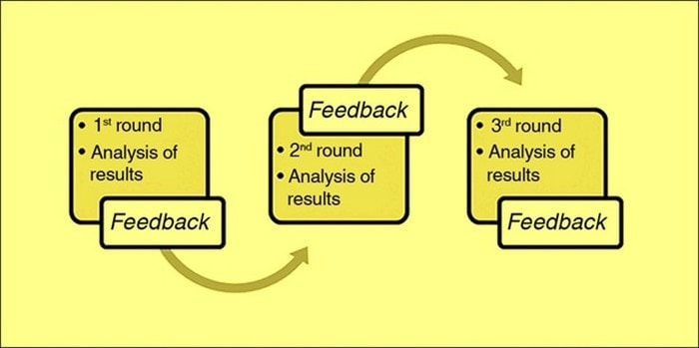
Open Schooling Together networking - brainstorm
Template/
mini-survey
brainstorm
discussion
Delphi
EVIDENCE
HOW
Students
Teachers
Communities
Practitioners
Researchers
Policy makers
Knowledge,
STEM literacy,
Active citizenship.
Teaching Practices
Pedagogical Knowledge
Open schooling views
scientific literacy
interest in science
(parents/families)
Educational
Resources
JournalArticle
Policybriefs / report
Events (workshops conferences)
WhiteBooks
Local policy support
Interest in science, self-efficacy, and career awareness
Teachers’
Interest and commitment
Influence EU call

Slide 8
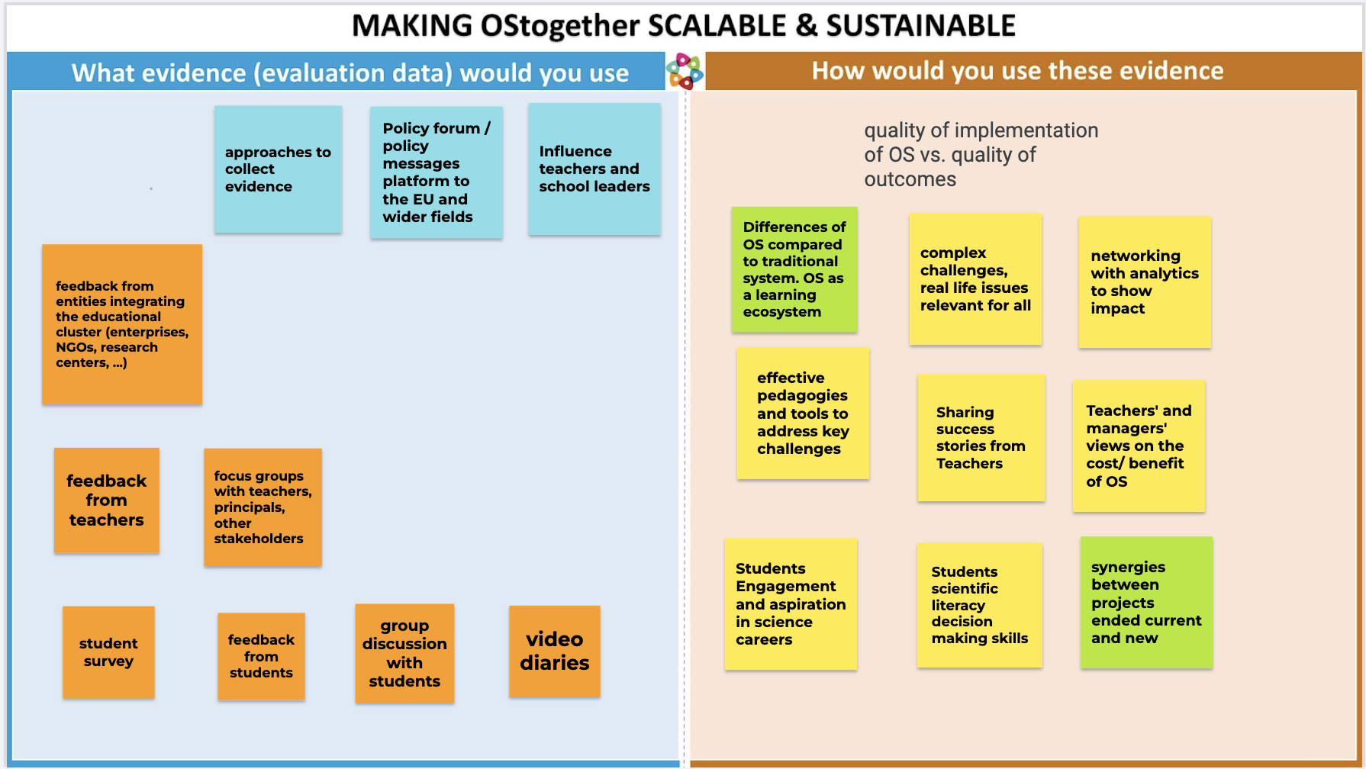

Slide 9
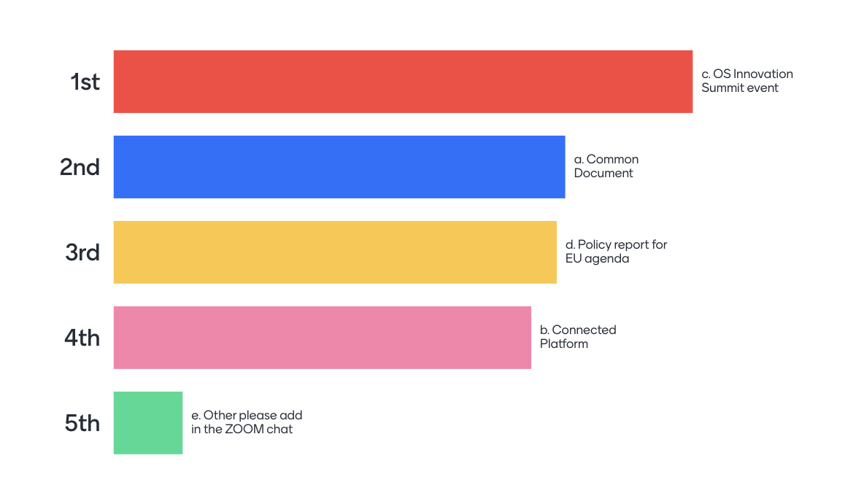
OS Together Agenda

Slide 10
Evaluation approaches for measuring the impact of open schooling
Please check the logo of your project and reuse it in your slide

Slide 11
Evaluation approaches for measuring the impact of open schooling

Slide 12



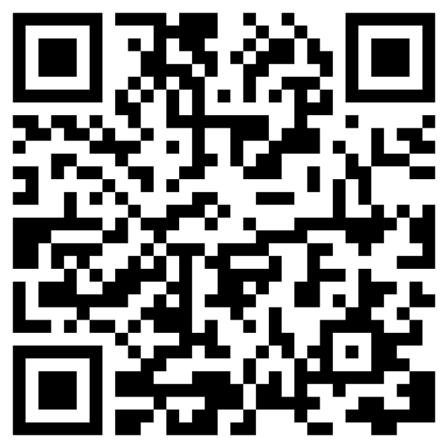
PULCHRA
Participatory Urban Learning Community Hubs Through Research and Activation
Project Objectives
To develop open-source educational e-material, e-guidelines and smartphone apps for analyzing the urban ecosystem and challenges.
To develop and use a City Challenges Platform amenable to students, parents, educators, citizens, scientists, local administrators including a collaboration feature allowing experts to guide non-experts in terms of the interpretation of findings.
To develop the City Science Teams with the participation of teachers and students, parents, professionals from the business community, scientists, local administrators, citizens, etc.
To “Experience Science” through the organization of two pilot City Challenges, in the science fields as related to the cities as urban ecosystems.
To bring real life projects as related to cities as urban ecosystems in the classrooms through focused collaborations with professionals and enterprises.
To motivate students towards new technologies, mainly the use of Earth Observation (Copernicus program and Sentinel missions) and navigation tools, etc.
Evaluation methodology
Evaluate progress and results (educational material, City Challenges, operation and usability of the City Solutions Platform, user-friendliness of website, of the PULCHRA app including the ODK based city climate apps) and identify changes to be made.
Define indicators for progress
Assess targets set in terms of gender issues
Assess the environmental and social impact assessment of the project
Apply usability testing of the City Solutions Platform for Open Schooling.
Evaluation instruments:
Questionnaires for students, teachers and stakeholders
EVALUATION TEAM: Stefanos Georganos (Leader), Christina Garoufalia, Premysl Stych, Tim Reichenau, Karl Schneider, Jan Blažek, Georgia Chatziparaskeva, Inese Liepina, Marco Contin, Aileen Bright, Ela Wołoszyńska-Wiśniewska, Ciprian Fartusnic

Slide 13
Evaluation approaches for measuring the impact of open schooling

Slide 14
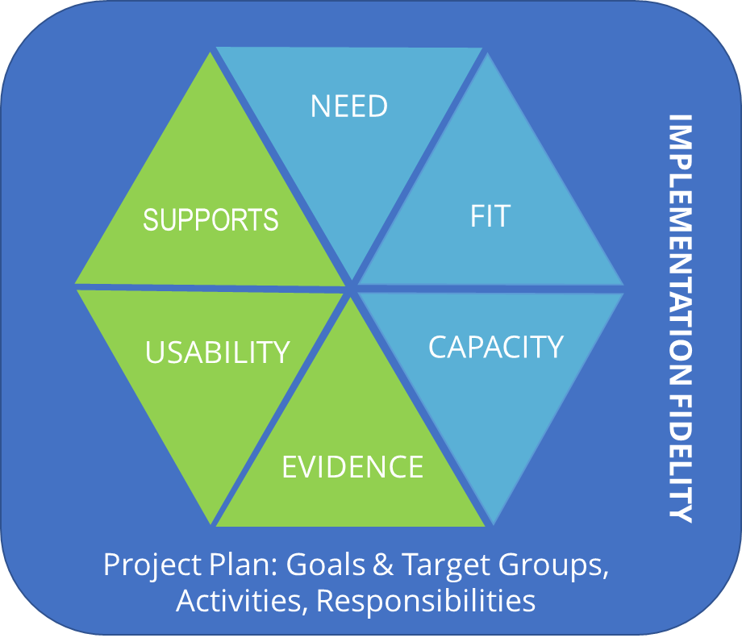
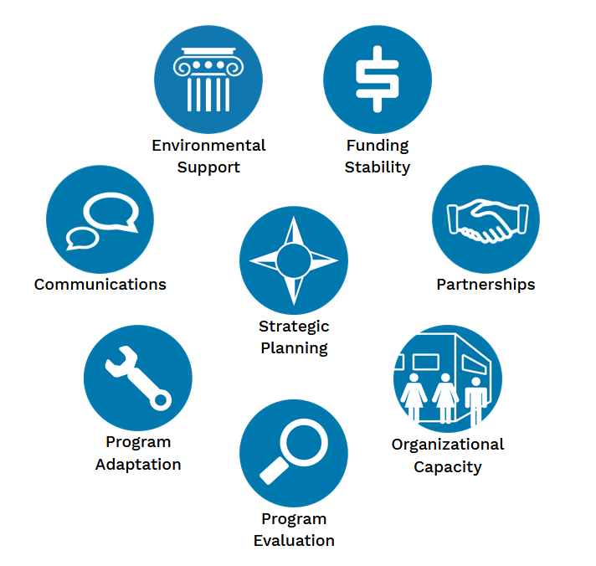
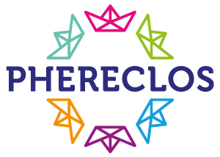
Project: Phereclos - Partnerships for pathways to Higher Education and science engagement in
Regional Clusters of Open Schooling
Project Objectives:
Establishment of 6 Local Education Clusters (LEC)
Mentoring in 10 cross-sectoral Transnational Education Mentoring Partnerships (TEMPs)
Assessment of regional effectiveness & impact to generate transferable implementation guidelines & policy briefs
Development of a Good Practice Library, a White Book on Open Schooling Education Clusters and a Teacher Training Innovation Toolkit
Implementation of digital representation of accomplishments with a OpenBadge ecosystem
Evaluation approach:
Overall: Achievement of project objectives is reflected in the deliverables
Supporting LECs in self-evaluation (formative & summative) through the use of Frameworks from Implementation Science
(Hexagon Model & Program Sustainability Assessment Tool)
Evaluation instruments:
Self-assessment tool for the LECs to support implementation planning & execution as well as sustainability
Self-assessment of goal achievement
In addition: Objective data
(Key Performance Indicators for assessing the Reach)
Your QR URL
EVALUATION TEAM:
https://nirn.fpg.unc.edu/resources/hexagon-exploration-tool
https://www.sustaintool.org/psat/

Slide 15
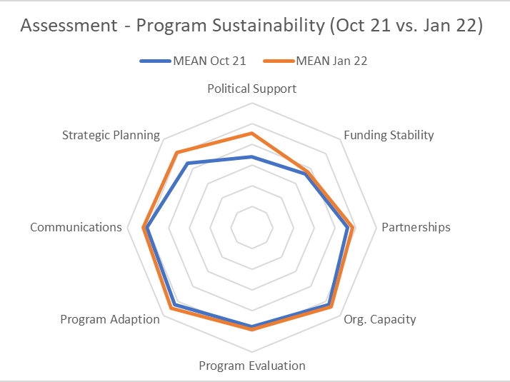
Project: Phereclos - Partnerships for pathways to Higher Education and science engagement in
Regional Clusters of Open Schooling
Resources: Initiatives (LECs & TEMPs): https://www.phereclos.eu/initiatives
Policy briefs: https://www.phereclos.eu/policy-briefs/
Inspiring Cases: https://www.phereclos.eu/practices In preparation: Whitebook, Teacher Training Toolkit
Open badges: https://www.phereclos.eu/badge/
Current Results:
Innovation Indicators: EVIDENCE was estimated as low, USABILITY and SUPPORT as moderate
System Indicators: FIT and CAPACITY was estimated as high, NEED as moderate
Very high Reach (KPIs)
  Schools: N=214; children: N=9636;
  teachers: N=1226; parents: N=2456
  Universities: N=34; researchers: N=494;
  teacher training students: N=155
  Economies/industries: N=36
  NGO: N=33
  Governmental Organizations: N=38
  Policy Makers: N=39
Challenges: LECs differed very much in their approaches & regional prerequisites => different barriers & facilitators for implementation; implementation strategies necessary to show need => participatory approach; LECs as Pilots: Theory of Change & profound evaluation needed to reach more evidence => continuous improvement of OS activities
Your QR URL
EVALUATION TEAM:
LEC implementation teams
supported by Monika Finsterwald & Marlene Kollmayer (UNIVIE)

Slide 16
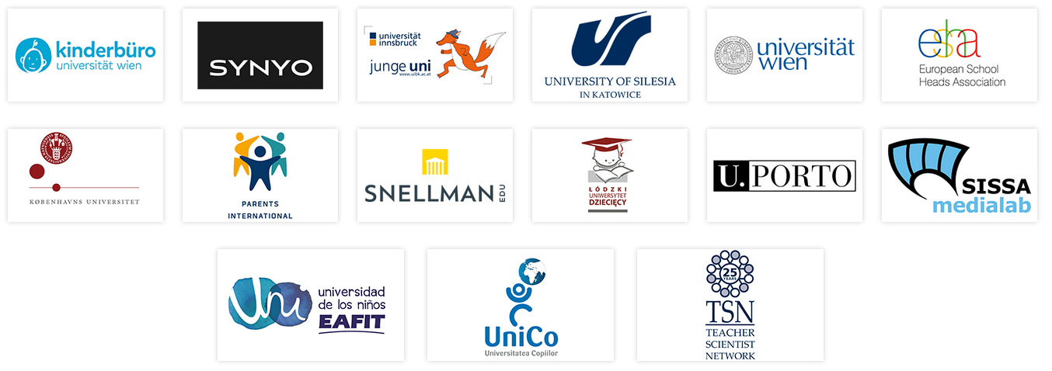
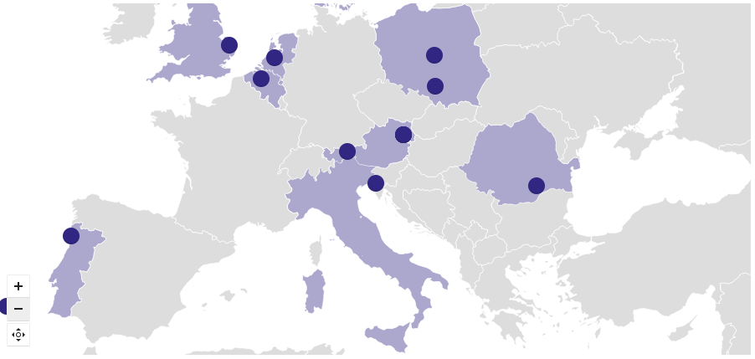

Phereclos - Partnerships for pathways to Higher Education and science engagement in
Regional Clusters of Open Schooling
Project
Consortium
Project Map
https://www.phereclos.eu/
Your QR URL
Project Coodinator:

Slide 17

Evaluation approaches for measuring the impact of open schooling

Slide 18
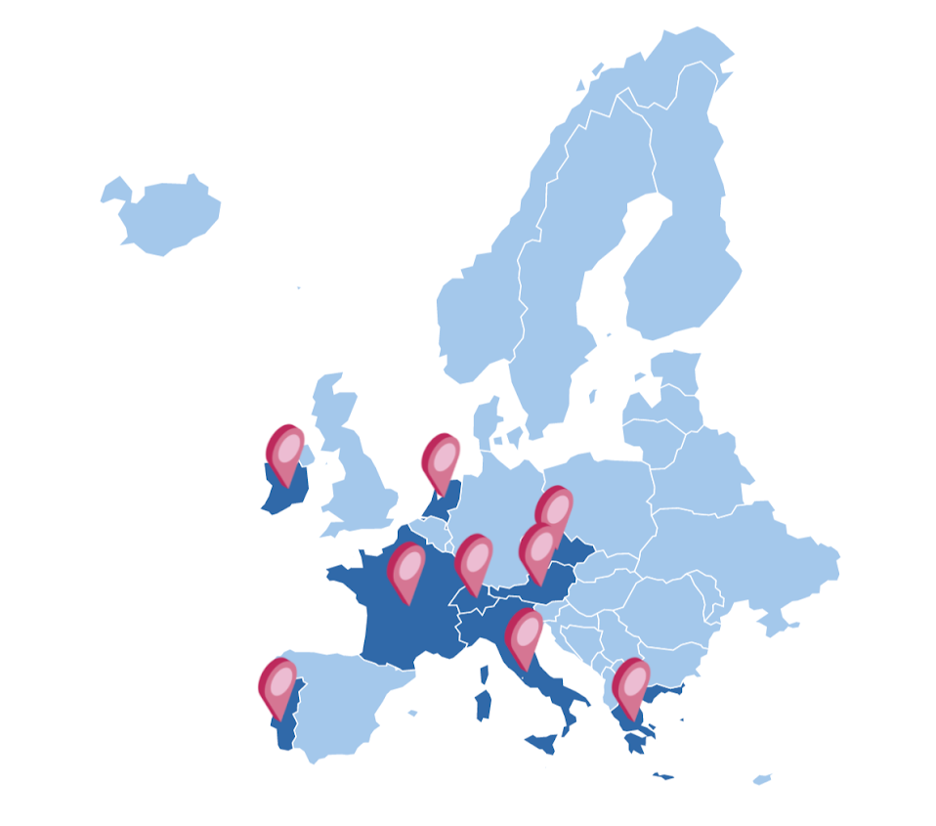



Project: Open Science Hub (OSHub.net)
  1. Maker
  Spaces
  2. Relationship Facilitators
  3. Education Brokers
Project Coordinator
University of Leiden
Website:
OSHub.network

Slide 19
Project: Open Science Hub (OSHub.net) - Methedologies
Project Objectives:
Evaluation Objectives:
Supports schools and local stakeholders to use research and innovation as a tool for tackling local challenges and contributing to sustainable community development
Work as mediators in each local community, positioning schools as active agents for collaboration
How does open schooling impact participants:
Students : Knowledge, STEM literacy, Active global citizenship.
Teachers : Training, Resources, Open schooling opinions.
Coordinators : Development and coordination of OSHubs.
Evaluation methodology:
Evaluation instruments:
A multilevel evaluation approach that examines
The OSHub Consortium
Local OSHubs – Facilitators / Teachers
Individual Participants – Students / Teachers
Implementing a mixed method of approach of quantitative surveys, skill archives and qualitative interviews and reflection journals (zines)
Triangulation of results across tools using sets shared indicators.
Year 1 (Pilot projects) evaluation informed year 2 – focus on: Knowledge Developed, Skills gained, Process of project, student autonomy, higher reflection community.
Surveys: Students: Pre & Post – Demographic, Quantitative, STEAM Identities & Perception, Skill baselines
Reflective Interviews: Teachers and OSHub Coordinators
Skill Archive: 2 question survey it takes2-3 minutes. Learners identify skills they feel they have improved on Must provide justification. Logged 3-4 times.
Reflection Journal: Prompted reflections through arts and crafts. High degree of freedom for learners . High qualitative information . Apart of the learning process
EVALUATION TEAM (Trinity College Dublin):
Shaun Ussher, Eimear McDwyer
Website:
OSHub.network

Slide 20
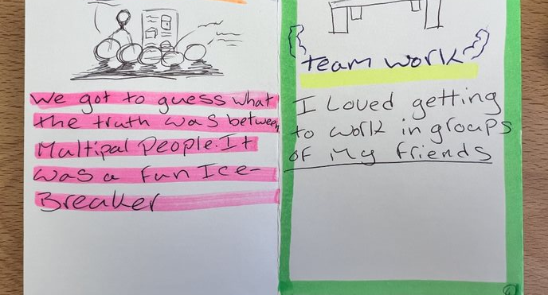
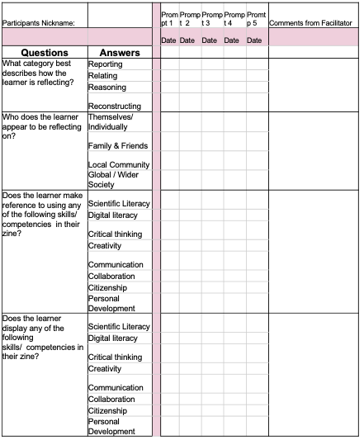
Project: Open Science Hub (OSHub.net) -Results
Skill Archive:
Reflection Journals:
^{No.} | Skill Used | Quote | Indicator
1st | Creative skills | I started thinking more and started having a big imagination | Cognitive Traits – Imagination
2nd | Communication skills | I improved because everyone got to speak in the group and I felt more comfortable. | Understanding others views
Collaboration | Establishing shared understanding | EA
 | Maintain team organisation | EB
 | Maintain a healthy relationship | EC
Communication | Understanding others views | FA
 | Expressing views | FB
 | Formats of communication | FC
Citizenship and Community | Community work | GA
 | Greater knowledge of community | GB
 | Global citizenship | GC
Personal Development | Activating knowledge gained | HA
 | Exposure to new knowledge | HB
 | Personal Changes | HC
Scientific Literacy | Explain phenomena scientifically | AA
 | Evaluate and design scientific enquiry | AB
 | Interpret data and evidence scientifically | AC
Digital Literacy | Operations and Concepts | BA
 | Uses of Technology | BB
 | Ethics and Safety | BC
Critical Thinking | Exploring and Understanding | CA
 | Representing and Formulating | CB
 | Monitoring and Evaluating | CC
Creativity | Creative Expression | DA
 | Knowledge Creation | DB
 | Cognitive Skills | DC
Next Steps:
Currently finishing data analysis from each tool.
Comparing across location & gender
Evaluation handbook for open schooling due in September
Final report & paper in October
Survey: 180 response pre/post student surveys.
Interviews from each hub coordinator & teachers of students
EVALUATION TEAM (Trinity College Dublin):
Shaun Ussher, Eimear McDwyer
Website:
OSHub.network

Slide 21
Evaluation approaches for measuring the impact of open schooling

Slide 22
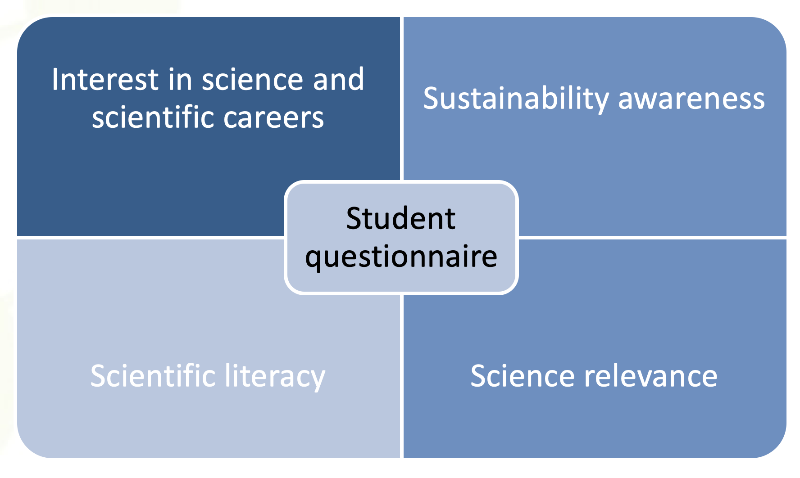
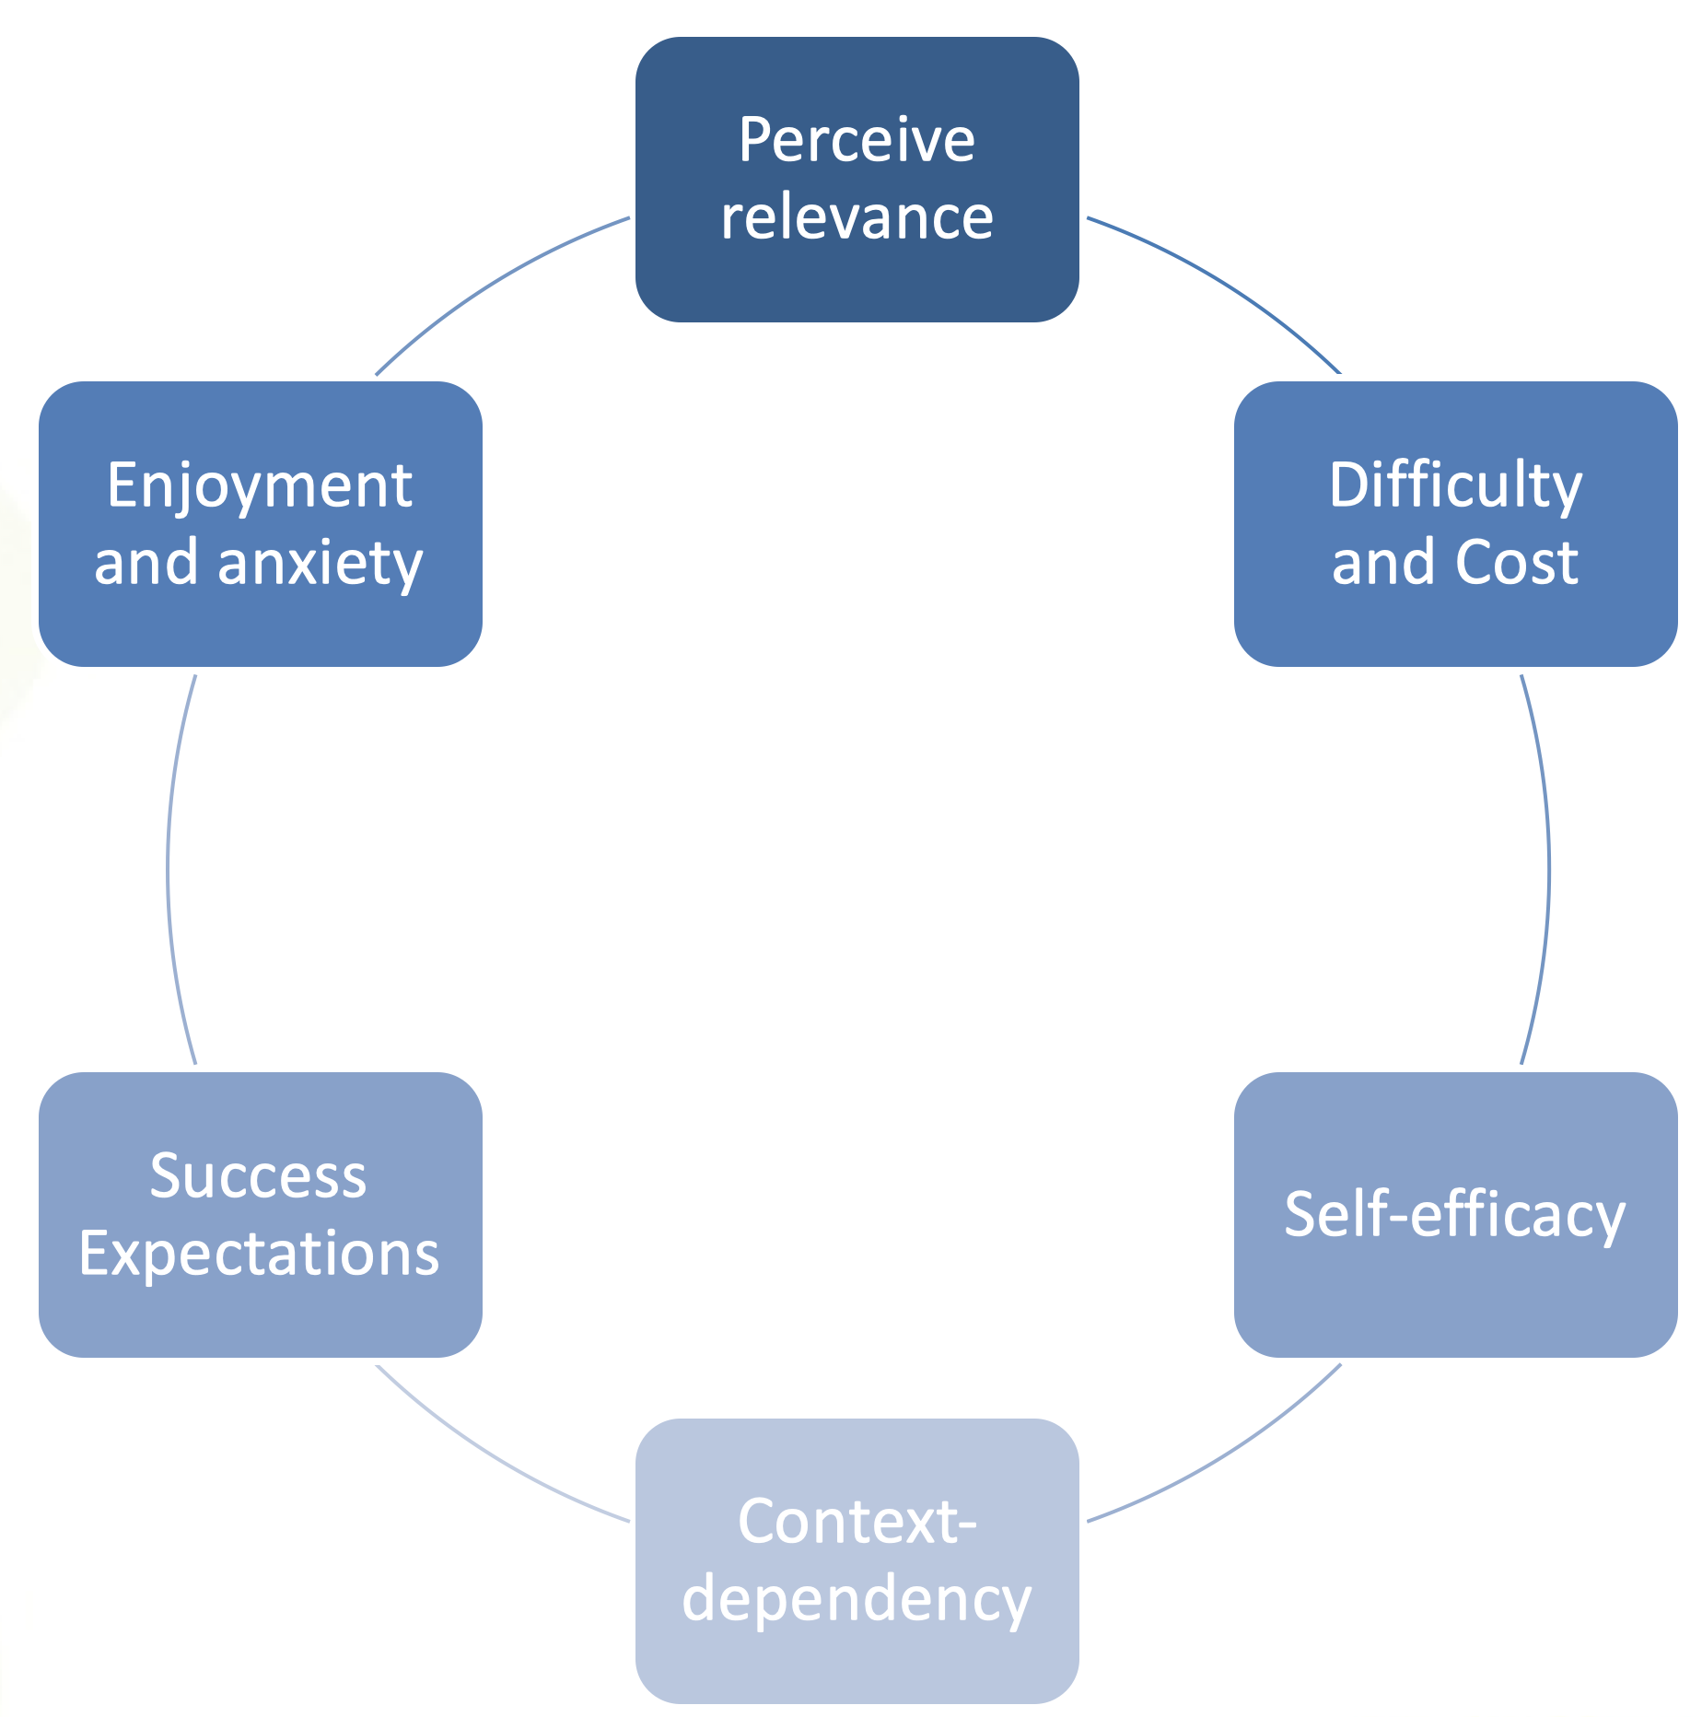

MOST - Meaningful Open Schooling Connects Schools To Communities
Objectives: to establish Open Schooling Communities across Europe and an European Open Schooling Network as means to:
Raise interest in science and science related careers
Increase scientific literacy and consciousness of and responsibility for environmental problems
Evaluation methodology
Evaluation instruments
Participatory approach
Mix methods
Mix methods
Pre/post students’ questionnaires
Teacher questionnaires
Case study:
Student group interview
Adult group interviews (teacher, school leader, community members)
Teacher questionnaire
Your QR URL
EVALUATION TEAM:
Marta Romero Ariza
Antonio Quesada Armenteros
Ana María Abril Gallego y María Martín Peciña

Slide 23
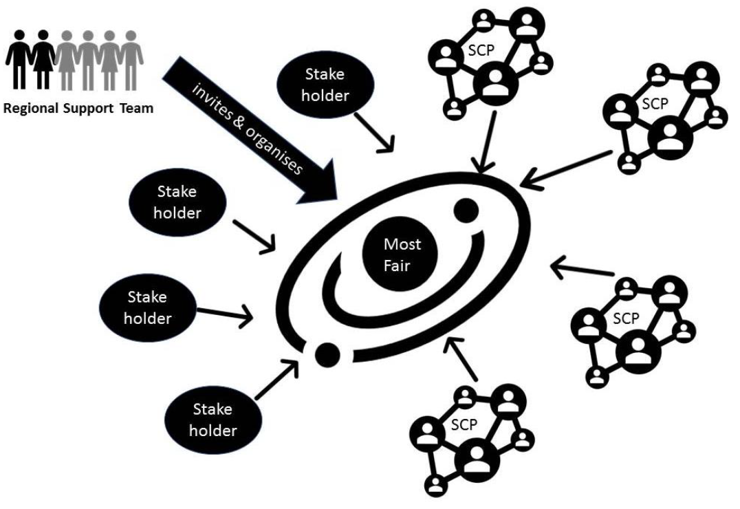
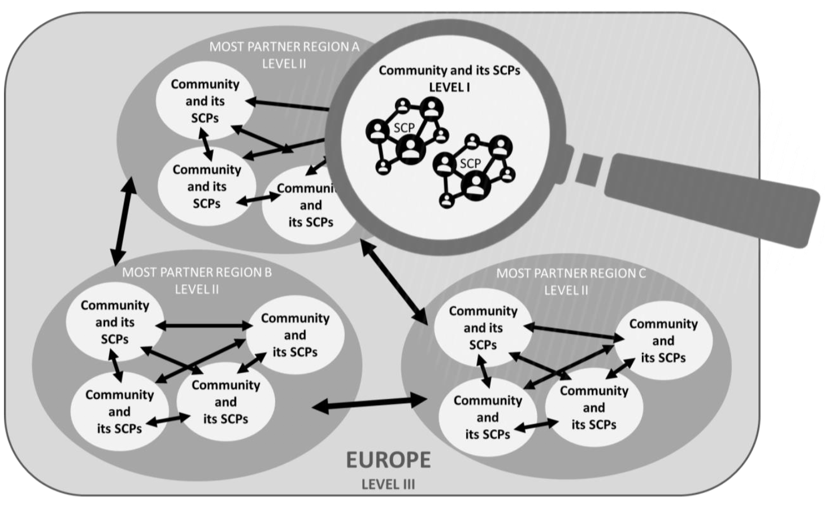
MOST - Meaningful Open Schooling Connects Schools To Communities
School manual
Pedagogical guidelines
Exemplary materials
Guidelines for Fairs
Regional Partnership
Resources
Expected, Preliminary or Current Results:
Strategies for impact:
254 School-Community-Projects (SCP)
35.298 participants from 10 countries
8966 students
1.123 teachers
25.190 people from the community
Challenges for evaluation
A wide variety of SCP
A wide student age range
EVALUATION TEAM:
Your QR URL
Marta Romero Ariza
Antonio Quesada Armenteros
Ana María Abril Gallego y María Martín Peciña

Slide 24
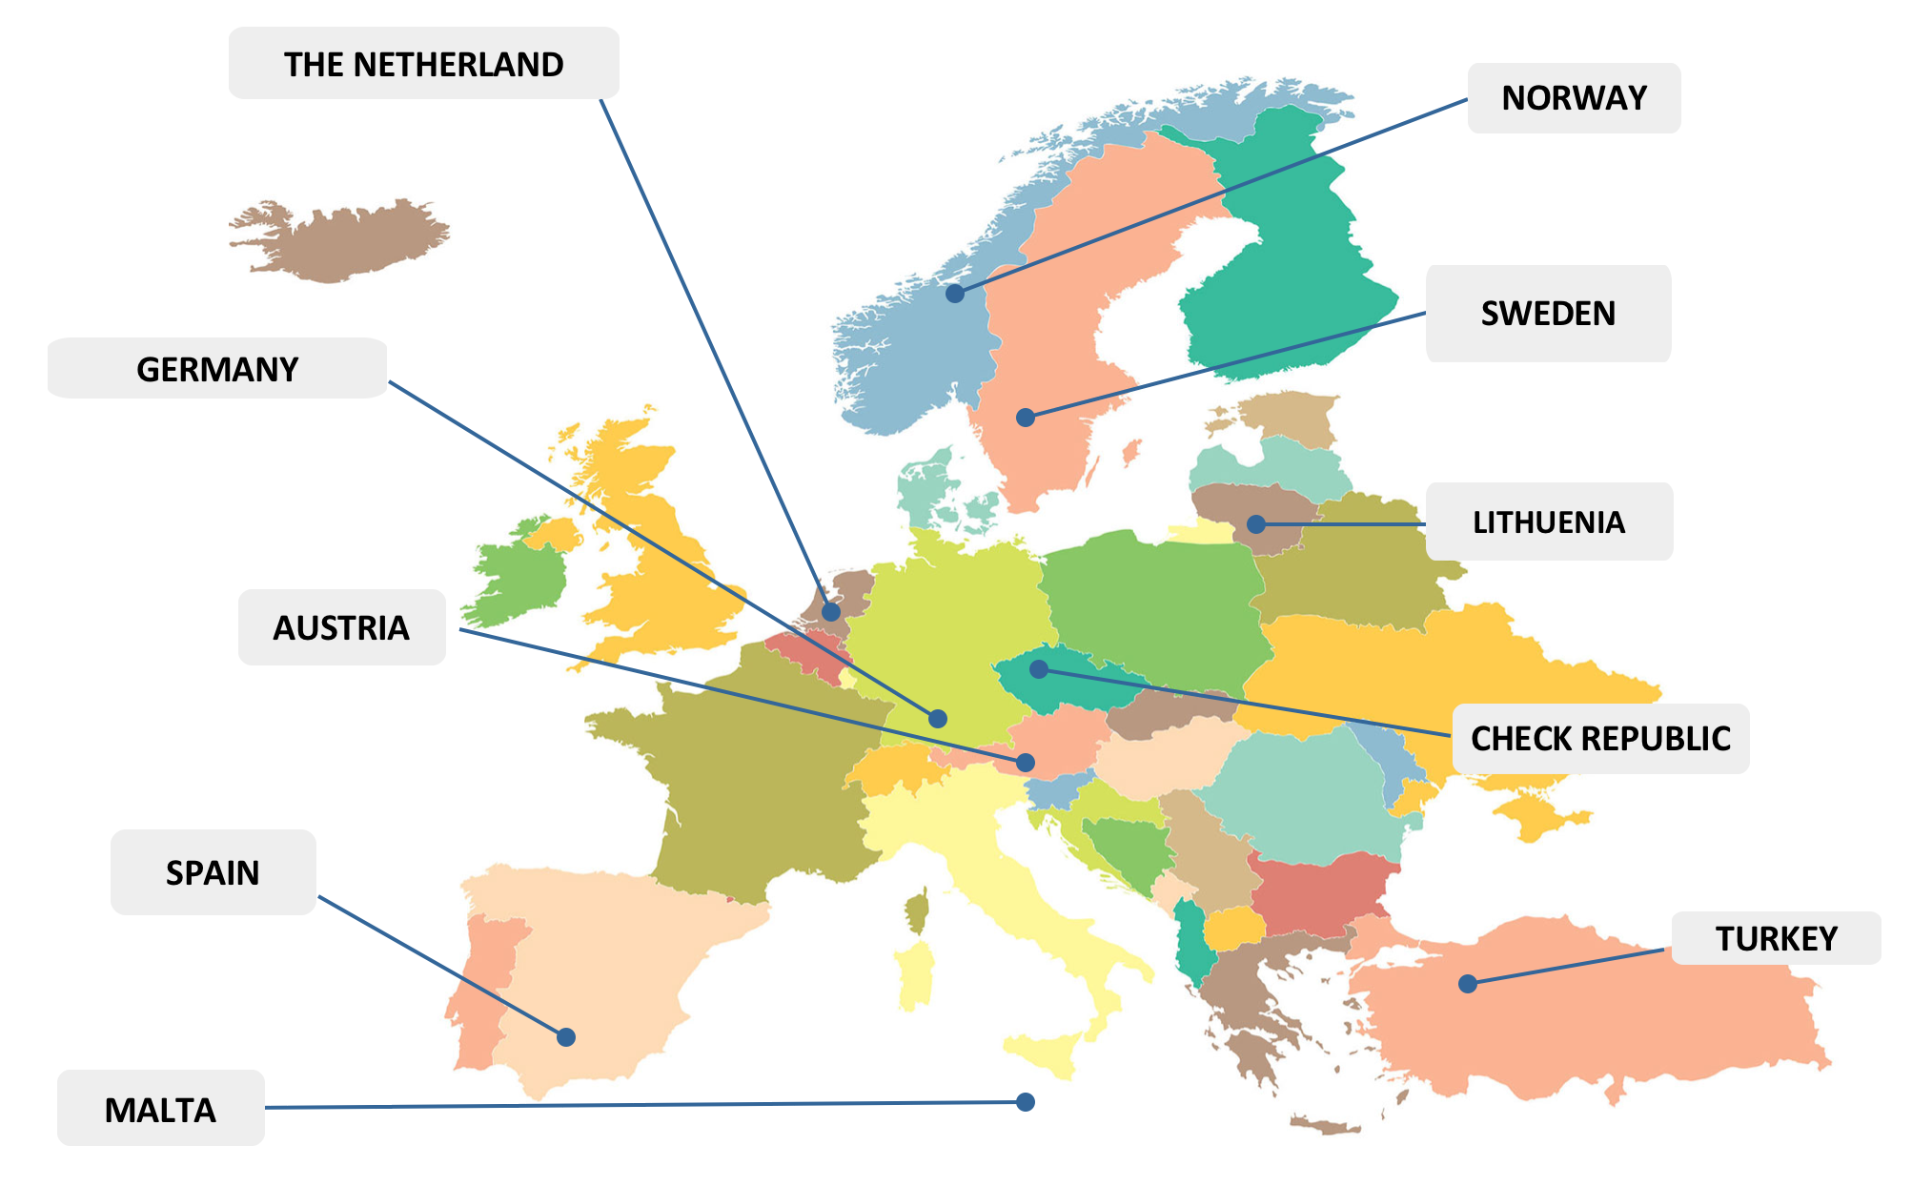
MOST - Meaningful Open Schooling Connects Schools To Communities
Project Map
https://icse.eu/international-projects/most/
Your QR URL
Project Coordinator:
Katja Maass
University of Education Freiburg (PHFR)
:

Slide 25
Evaluation approaches for measuring the impact of open schooling

Slide 26
Project: Make it Open
Objectives:
The overall objective of Make it Open is to develop a sustainable infrastructure of open schooling in Europe, based on the approach, pedagogy, content, processes, and tools of the maker movement, including:
positioning schools at the centre of community wellbeing,
introducing maker education, citizen science and constructionism learning as the three “transformational approaches” to teaching and learning STEAM,
increasing the level of scientific literacy and interest in science of students and parents
mainstreaming open schooling
Develop recommendations for the improvement and scaling of the process, products and tools.
Describe and characterise the hubs (Communities of Practice and Communities of Learners) that will implement the Make it Open approach and create recommendations for the working processes and functioning according to the project goals.
Assess project’s impact on the level of scientific literacy and interest in science of students and parents.
Evaluation methodology:
Evaluation instruments:
Products analysis – documentation analysis, analytics.
Processes – e-journals, focus group interviews, workshops.
Project’s impact – questionnaires (teachers & students), drawing task (students), case studies.
Your QR URL
EVALUATION TEAM: Katarzyna Potęga vel Żabik (Copernicus Science Centre, Poland)
Chagit Tishler (Bloomfield Science Museum Jerusalem, Israel),
Tamar Furhmann (Columbia University, USA)

Slide 27
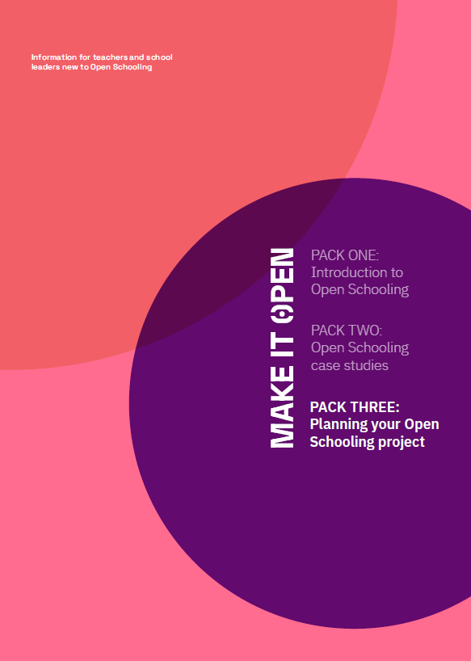
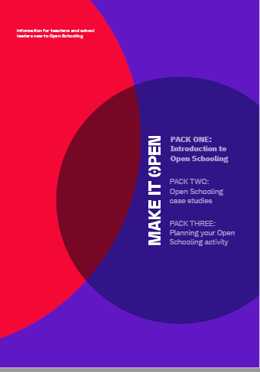
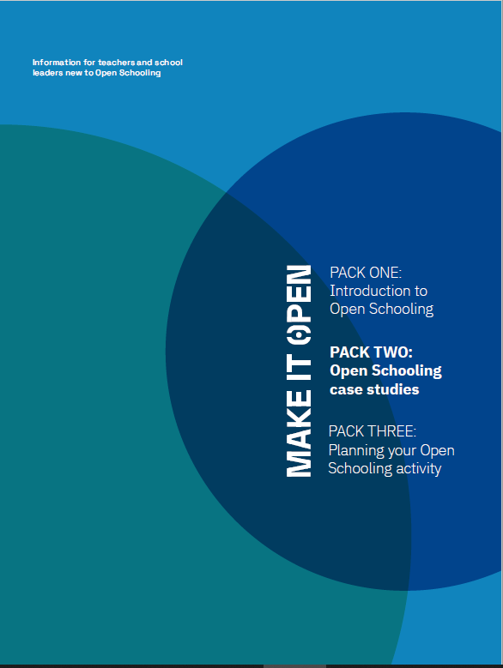
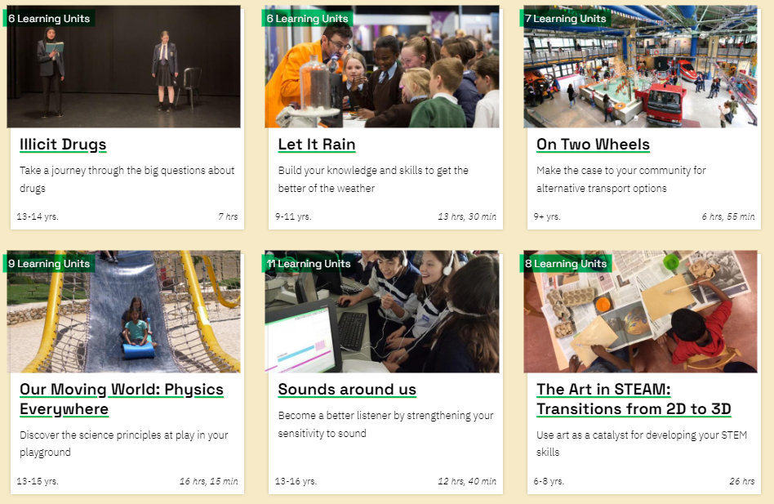
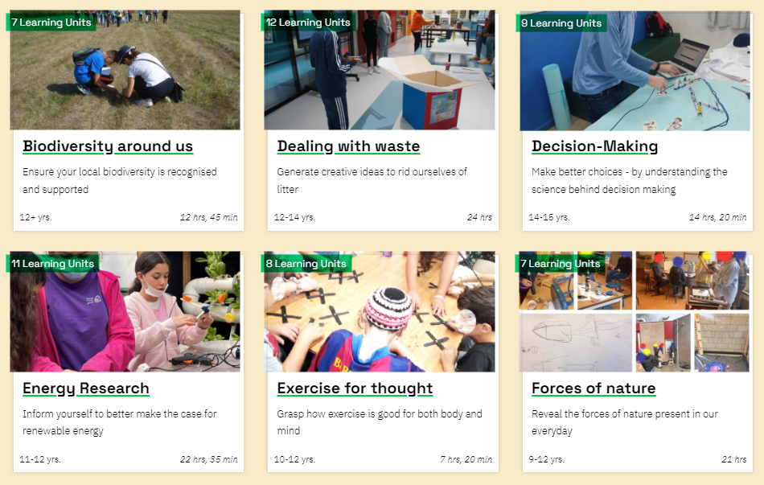
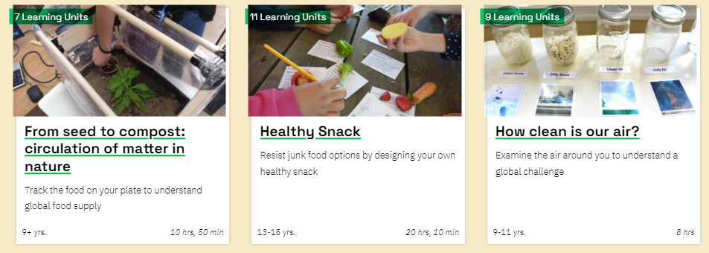
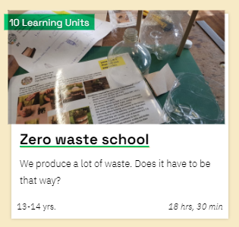

Project: Make it Open
Resources:
Open Schooling Information Packs
16 Open schooling Learning Scenarios
Open schooling MOOC
(2023)
Avalible at the Navigator
Expected, Preliminary or Current Results:
From research conducted among teachers participating in the project's pilot phase, we identified challenges in running open schooling activities. These include networking with experts, managing group work, and organizing visits to institutions.
Based on the initial pilot data, we expect that participation in open schooling activities in the later stages of the project:
will increase the declared willingness of teachers to use OS activities such as meetings with experts and lessons outside the school building in their daily pedagogical practice.
will increase the involvement and motivation of students and parents in OS activities related to making and citizen science.
will broaden students' conceptualisation of the learning environment.
Challenges and Strategies for impact:
Support 10 national Open Schooling Hubs in introducing the Make it Open methodology to 150 schools by:
establishing and coordinating the local hubs with various partners, representing the different stakeholders,
creating a one-stop shop that will guide schools and teachers through the process of running their learning scenarios and using additional resources,
ensuring stakeholders' engagement at all stages of the project in supporting schools.
Your logo
Your QR URL
EVALUATION TEAM: Katarzyna Potęga vel Żabik (Copernicus Science Centre, Poland)
Chagit Tishler (Bloomfield Science Museum Jerusalem, Israel),
Tamar Furhmann (Columbia University, USA)

Slide 28
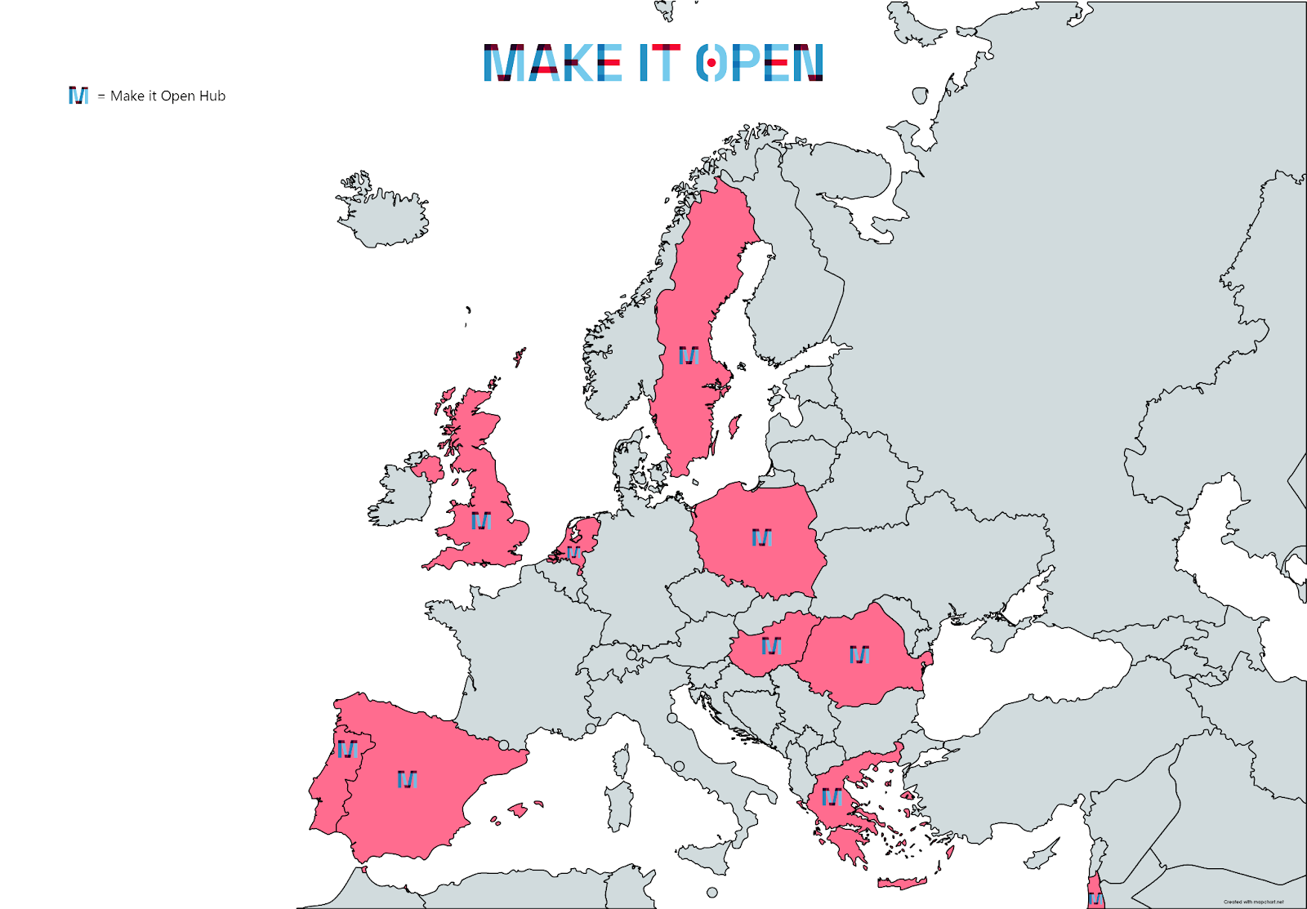






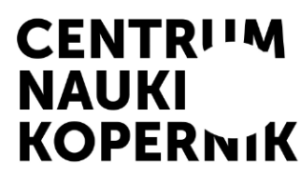


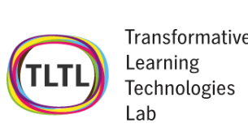


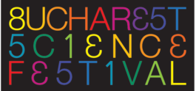
Project: Make it Open
Project Map
Project Consortium
Practice Partners
+ OS Hubs
Networks
+ Academic
Third parties – OS Hubs
150 schools in Greece, Hungary, Israel, The Netherlands, Poland, Portugal, Romania, Spain, Sweden and the UK
https://makeitopen.eu/
Your logo
Your QR URL
Project Coodinator: Bloomfield Science Museum Jerusalem

Slide 29
Evaluation approaches for measuring the impact of open schooling

Slide 30












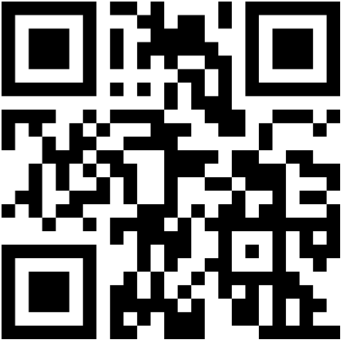
Project: CONNECT - Inclusive Open Schooling with Engaging and Future-oriented Science
Objectives
To create an inclusive and sustainable model for open schooling with structured materials and open scenarios.
To support 1,000 teachers to adopt open schooling in the core curriculum, involving universities, enterprises and families.
To empower 10,000 disadvantaged students by increasing their science capital, learning mindset and science aspiration.
Evaluation methodology
Our multi-methods focuses on 3 issues:
How can the interaction between scientists, teachers, families and students be facilitated for effective learning?
What are the drivers and barriers for teachers to adopt open schooling?
How can disadvantaged students get more experience and insights into STEM jobs?
Evaluation instruments
Interviews, testimonials and analytics.
Teachers’ self-assessment tool of pedagogical practices & strategies for open schooling with open badge.
Students’ self-assessment tool to reflect about science capital, learning mindset, and science aspiration with open badge.
EU Missions + SDGs
Green Competences
Open Scenario Formats
Soil
Food
Global
warming
Cimate
neutral
Clean
Water
Cancer
& Health
Envision
Futures
Embrance
Complex
Take
action
Value
Nature
consensus
cocreation
jury
EVALUATION TEAM: Alexandra Okada (leader), Tony Sherborne(UK),
Rosina Malagrida (Spain), Mihai Bizoi (Romania), Giorgos Panselina (Greece), Patricia Torres (Brazil south) and Silvar Ribeiro (Brazil northeast)

Slide 31









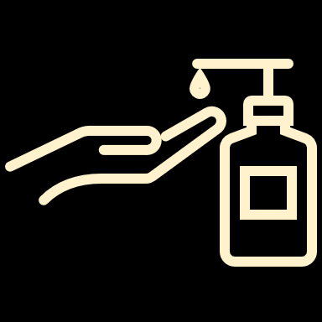



Project: CONNECT - Inclusive Open Schooling with Engaging and Future-oriented Science
Open Educational Resources (sample)
Return
extinct animals
Reduce
microplastics
Promote
energy-saving
white
pollution
Reach
carbon zero
Solve problems
with maps
Decide about
transplants
COVID-19
prevention
COVID-19
ventilation
COVID-19
handwashing
COVID-19
aerosol indoors
COVID-19
masks
Next Challenges and Strategies:
Half of the students had low science capital in all dimensions. 60% considered science enjoyable and fun, but there were 32% who would not like to be seen as an expert in science nor to have a job that uses science.
Next Steps:
Support teachers with coaches, resources, examples of
best practices and policy recommendations.
Help students increase their confidence in science with the CARE-KNOW-DO framework for them to acquire, apply, transfer and master science knowledge and skills to solve real-life problems.
Preliminary Results (Jan-Dez 2021)
12 sets of resources for teachers, learners, scientists & families
57 best practices, 198 teachers, 36 scientists, 22 ambassadors
1359 students completed OS projects and evaluation:
735 felt confident that did well in their science project
542 felt confident talking about science
537 felt confident about their knowledge in science
549 would like to be seen as an expert in science
540 would like to have a job that uses science
(66% were girls)
EVALUATION TEAM: Alexandra Okada (leader), Tony Sherborne(UK),
Rosina Malagrida (Spain), Mihai Bizoi (Romania), Giorgos Panselina (Greece), Patricia Torres (Brazil south) and Silvar Ribeiro (Brazil northeast)

Slide 32
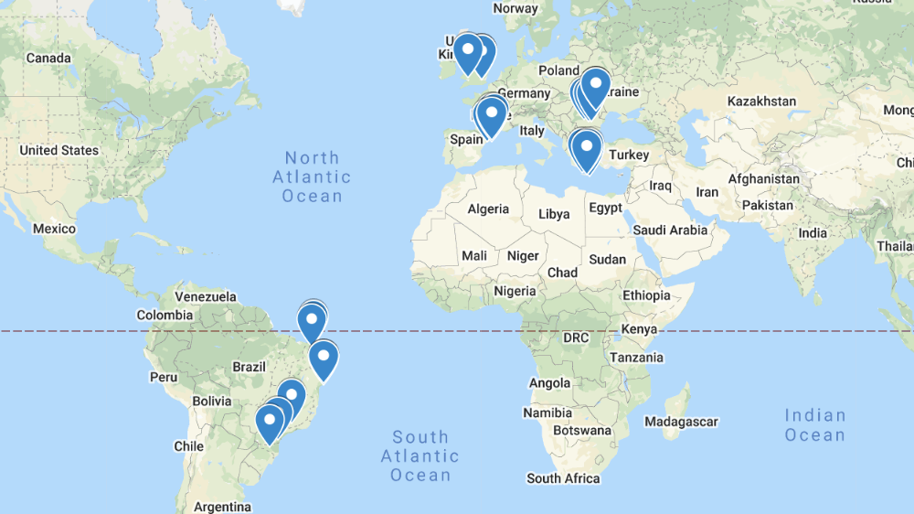

CONNECT - Inclusive Open Schooling with Engaging and Future-oriented Science
CONNECT Network
schools+universities+enterprises
PhD students examing Open Schooling
University-school partnership
(Maria Castro)
Teachers’ professional
development
(Vanessa Santana)
Young and Adults Mobile Learning
(Katiuscia Santos)
Knowledge network Communication
(Luziana Quadros)
Project Coordinators: OUUK Alexandra Okada (scientific coordinator),
EXUS Georgios Kolionis (project coordinator)

Slide 33
Evaluation approaches for measuring the impact of open schooling

Slide 34
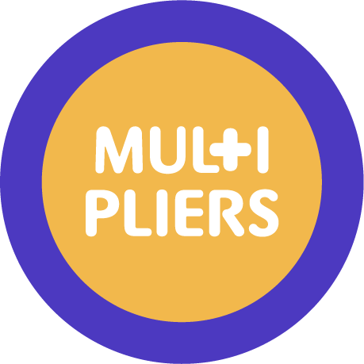
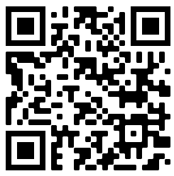
MULTIPLIERS – Partnerships to ensure meaningful engagement with Science and Society
Project Objectives
Establish sustainable open science communities (OSCs) consisting of students, schools, families, local communities, civil society organisations, informal learning providers, universities, the media, policy-makers, and industry, to cooperate and integrate the open schooling concept.
Increase students’ interest in science, self-efficacy for learning science, and their science career awareness by integrating real-life, open-school projects into science learning with the participation of science experts in authentic settings.
3: Develop analytical and critical thinking competencies s for students, families, and the wider community for problem solving and innovation through open-school science learning projects.
4. Provide educators and policy-makers with a set of guidelines and recommendations (the ‘MULTIPLIERS White Book’) for adopting open schooling.
5. Communicate and share the project ideas, good practices, and tools/materials with the widest possible range of institutions and individuals, including society.
Evaluation methodology
1. Assess the successful establishment of six OSCs as innovation hubs.
2. Assess the impact of the project on students’ interest in science , self-efficacy, and career awareness.
3. Assess the impact of the educational actions based on the open schooling framework on students’ critical thinking and argumentation skills.
4. Assess the quality of the content of the guidelines and recommendations through open consultation between a wide variety
of stakeholders.
5. Assess the number and the quality of communication and promotion activities performed, the countries reached, and the number of individuals and institutions engaged.
Evaluation instruments
Interviews
Questionnaire, interviews
Interviews/focus groups and observations
Focus groups
Interviews
EVALUATION TEAM: Annette Scheersoi; Amélie Tessartz (Coordination - Germany), Costas Constantinou; Irene Drymiotou (Cyprus); Digna Couso; Raquel Ríos Font (Spain); Gregor Torkar; Tim Prezelj (Slovenia); Christina Ottander; Jenny Sullivan Hellgren (Sweden).

Slide 35



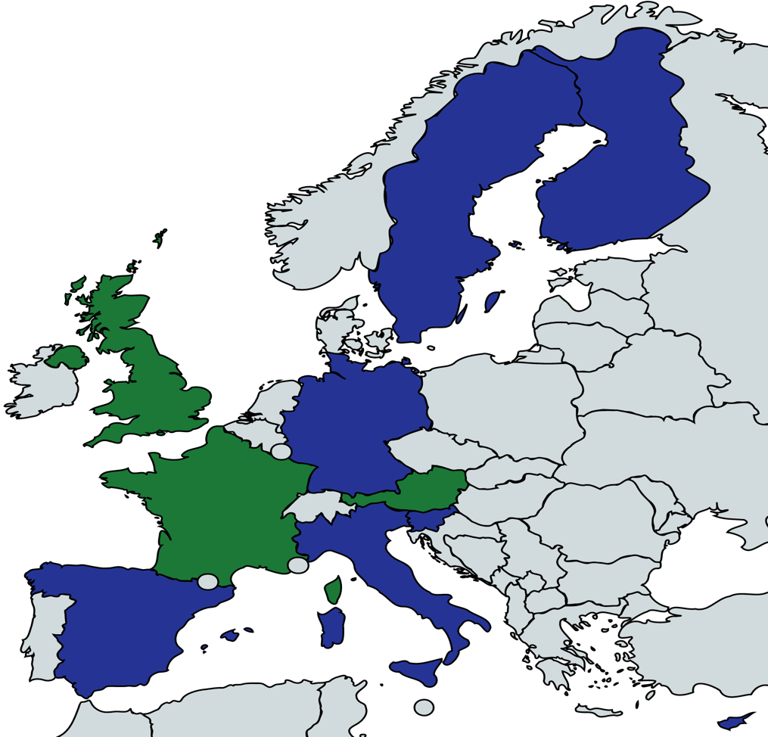






MULTIPLIERS – Partnerships to ensure meaningful engagement with Science and Society
Project Map
https://multipliers-project.org/
Project Coodinator:

Slide 36
Evaluation approaches for measuring the impact of open schooling

Slide 37
PAFSE – Partnerships for Science Education
Project Objectives
A. Create regional health education clusters of schools supported by stakeholders to promote innovative open ways of providing STEM learning for addressing public health issues.
B. Enhance the levels of scientific literacy and preparedness at the community level on public health challenges and introduce health education actions for community responsibility by the next generation.
C. Increase students’ competence to engage in project-based learning, their curiosity to look out for and make sense of the available evidence and their interest in STEM disciplines and health-related professions.
D. Provide an inclusive educational environment supported by a web platform for collaboration and dissemination of the teaching-learning experiences and educational resources
E. Develop instruments for formalizing the partnerships in order to promote sustainability of open schooling approaches to health education and community preparedness.
Evaluation methodology
1. Assess the impact of the project on students’ appreciation of fact-checking routines in dealing with misinformation, their attitudes to science and their aspirations for science-related careers.
2. Assess the future of health education partnerships and networks.
3. Assess participating community preparedness to reduce the risk of communicable disease and epidemics and the value of efforts to share experiences more globally.
4. Access teachers’ preparedness, interest and commitment to enact educational scenario on public health issues and to collaborate with stakeholders in organizing public consultation events with the local community.
Evaluation instruments
Questionnaire.
Interviews, documentation analysis (e.g.: MoU).
Questionnaire.
Questionnaire.
EVALUATION TEAM: Carolina Santos (Portugal), Vitor Santos (Portugal), Sofia Tavares (Portugal), Carlos Pires (Portugal), João Victor Rocha (Portugal) – coordination; Alain Areal (Portugal), Eliza Rybska (Poland), Costas Constantinou (Cyprus); Tassos Mikropoulos (Greece)

Slide 38


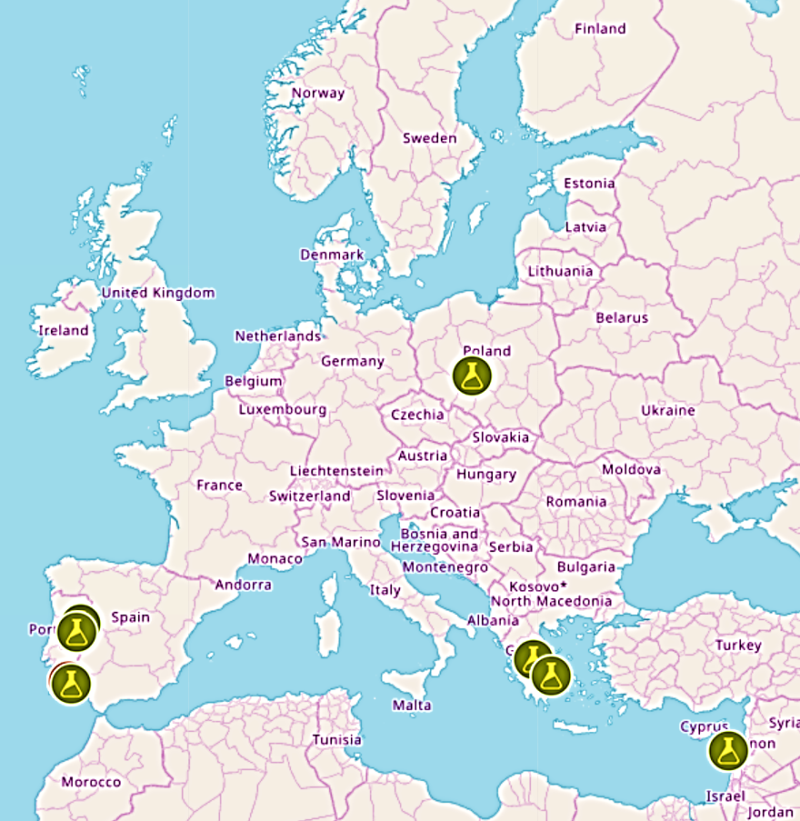



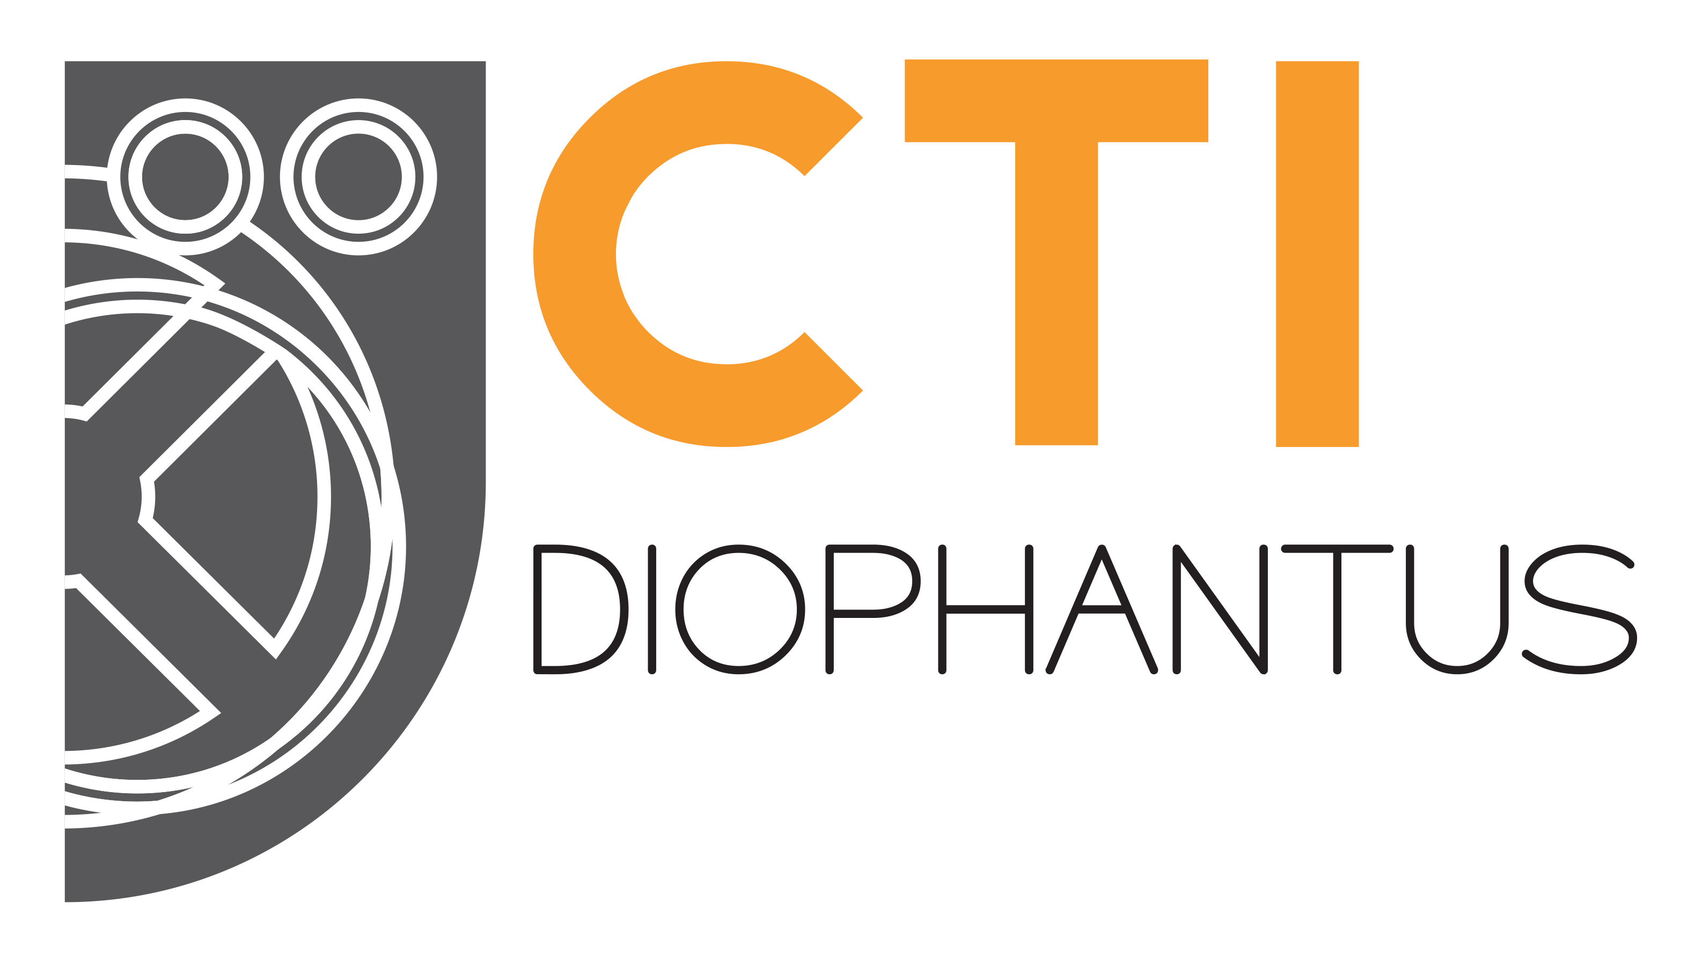
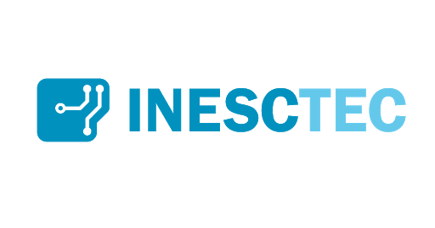



PAFSE – Partnerships for Science Education
Project Map
Project Consortium
Add your website here
we’ll create the QR code
Home - English - PAFSE
Your QR URL
Project Coodinator:

Slide 39
Evaluation approaches for measuring the impact of open schooling

Slide 40
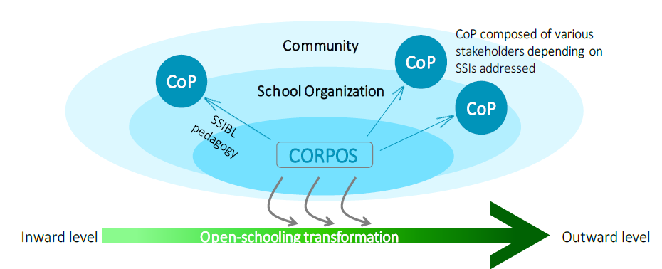
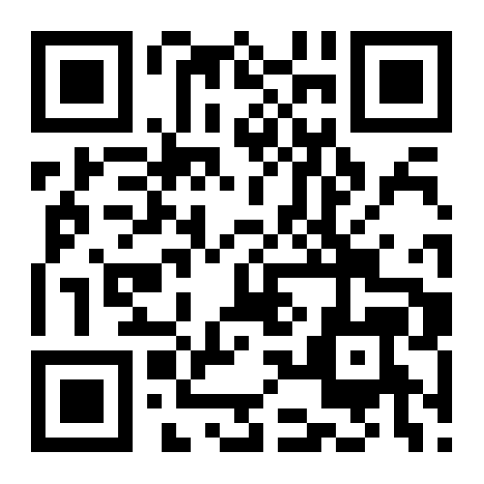
COSMOS – Creating Organisational Structures for Meaningful science education
through Open Schooling for all
Objectives:
Establish open schooling structures – CORPOS & CoP
Embed SSIBL pedagogy within CoPs to foster scientific literacy and responsible citizenship
Ensure the viability and sustainability of open schooling in science education
Your logo
EVALUATION TEAM: Jelle Boeve-de Pauw (WP leader), Mart Doms, Philippe Bastiaenssens
Karel de Grote University of Applied Sciences and Arts (Belgium)

Slide 41
COSMOS – Creating Organisational Structures for Meaningful science education
through Open Schooling for all
Objectives:
Establish open schooling structures – CORPOS & CoP
Embed SSIBL pedagogy within CoPs to foster scientific literacy and responsible citizenship
Ensure the viability and sustainability of open schooling in science education
Evaluation methodology
Our multi-methods focuses on 3 evaluation questions:
Stakeholder Outcomes (EQ1) – What is the effect of COSMOS implementation on students, teachers, school organisation and other stakeholders?
Pedagogical Processes (EQ2) – Which are the critical factors that facilitate or impede SSIBL-CoP implementation in the COSMOS schools?
Organisational Processes (EQ3) – Which are the critical factors that facilitate or impede viable and sustainable CORPOSs in schools?
Evaluation instruments
Level | What?
Students | Pre/post survey (PATS – SPAC) Group interviews (Teacher identity)
CoPs | Pre/Post interviews Reflective logging of observations of SSIBL-CoP implementations
CORPOS | Focus groups (School openness) Reflective logging of key contributors in change processes
Your logo
EVALUATION TEAM: Jelle Boeve-de Pauw (WP leader), Mart Doms, Philippe Bastiaenssens
Karel de Grote University of Applied Sciences and Arts (Belgium)

Slide 42
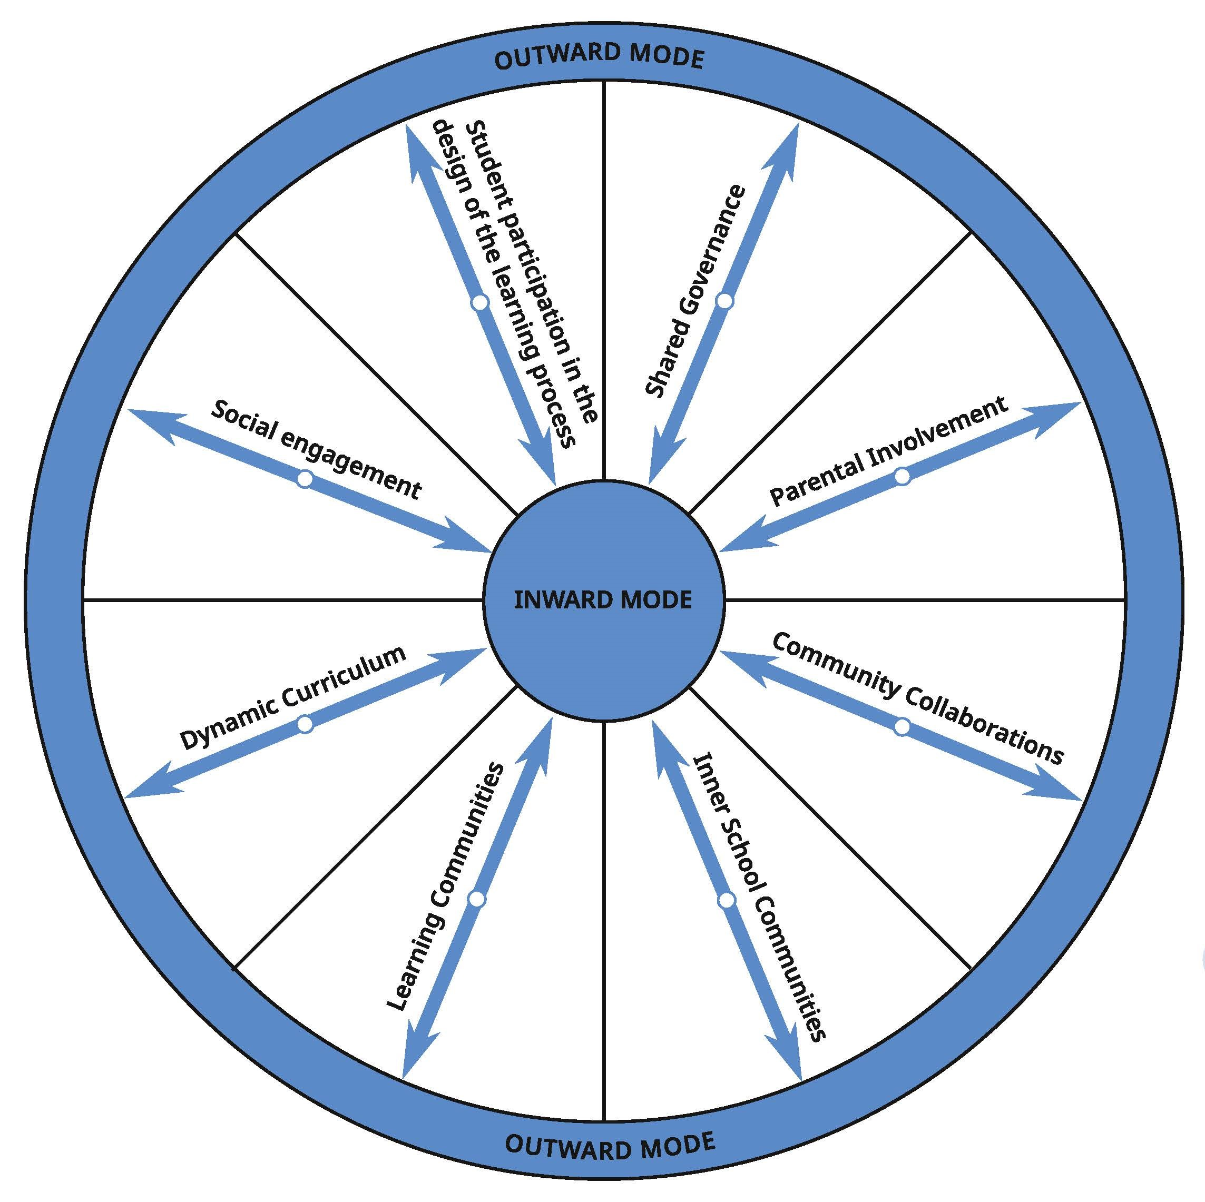
COSMOS – Creating Organisational Structures for Meaningful science education
through Open Schooling for all
Objectives:
Establish open schooling structures – CORPOS & CoP
Embed SSIBL pedagogy within CoPs to foster scientific literacy and responsible citizenship
Ensure the viability and sustainability of open schooling in science education
Project Coordinator: Dr. Marie-Christine Knippels
Freudenthal Institute, Faculty of Science (Netherlands)
Your logo

Slide 43
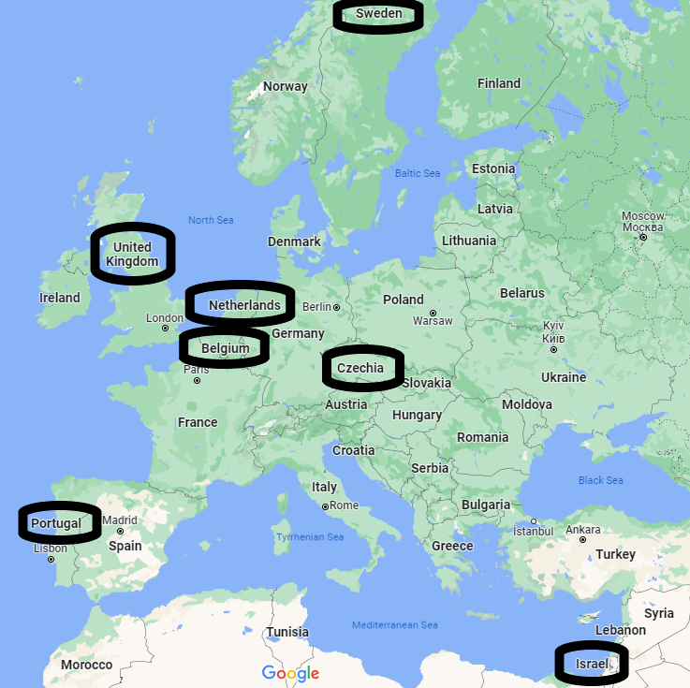
COSMOS – Creating Organisational Structures for Meaningful science education
through Open Schooling for all
Project Coordinator: Dr. Marie-Christine Knippels
Freudenthal Institute, Faculty of Science (Netherlands)
Your logo

