Slide 1

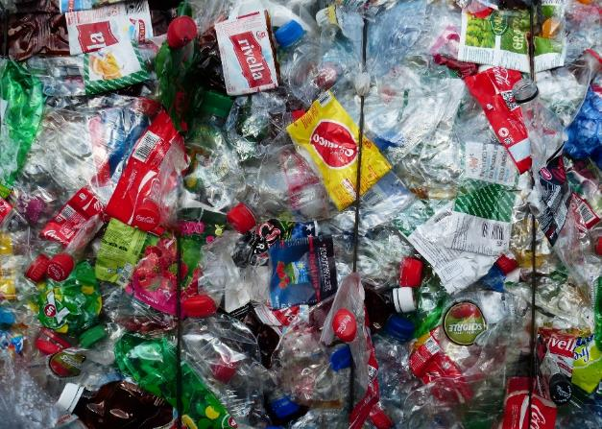
The Great Big Litter Hunt
Teaching presentation

Slide 2


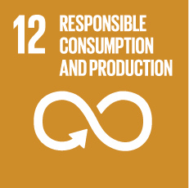


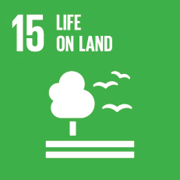
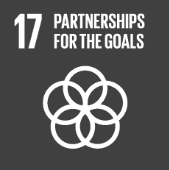

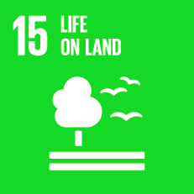
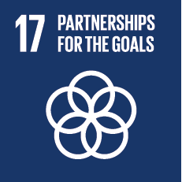


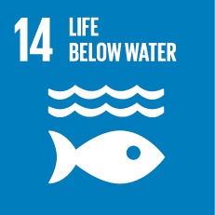


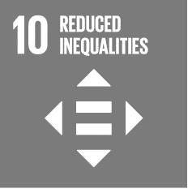





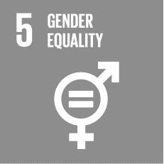
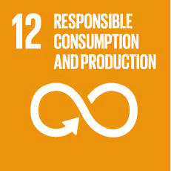

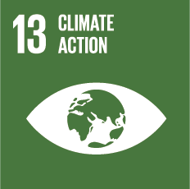



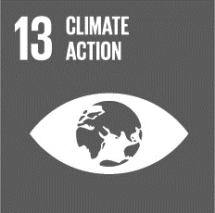
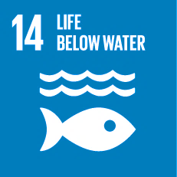







In compliance with

Slide 3
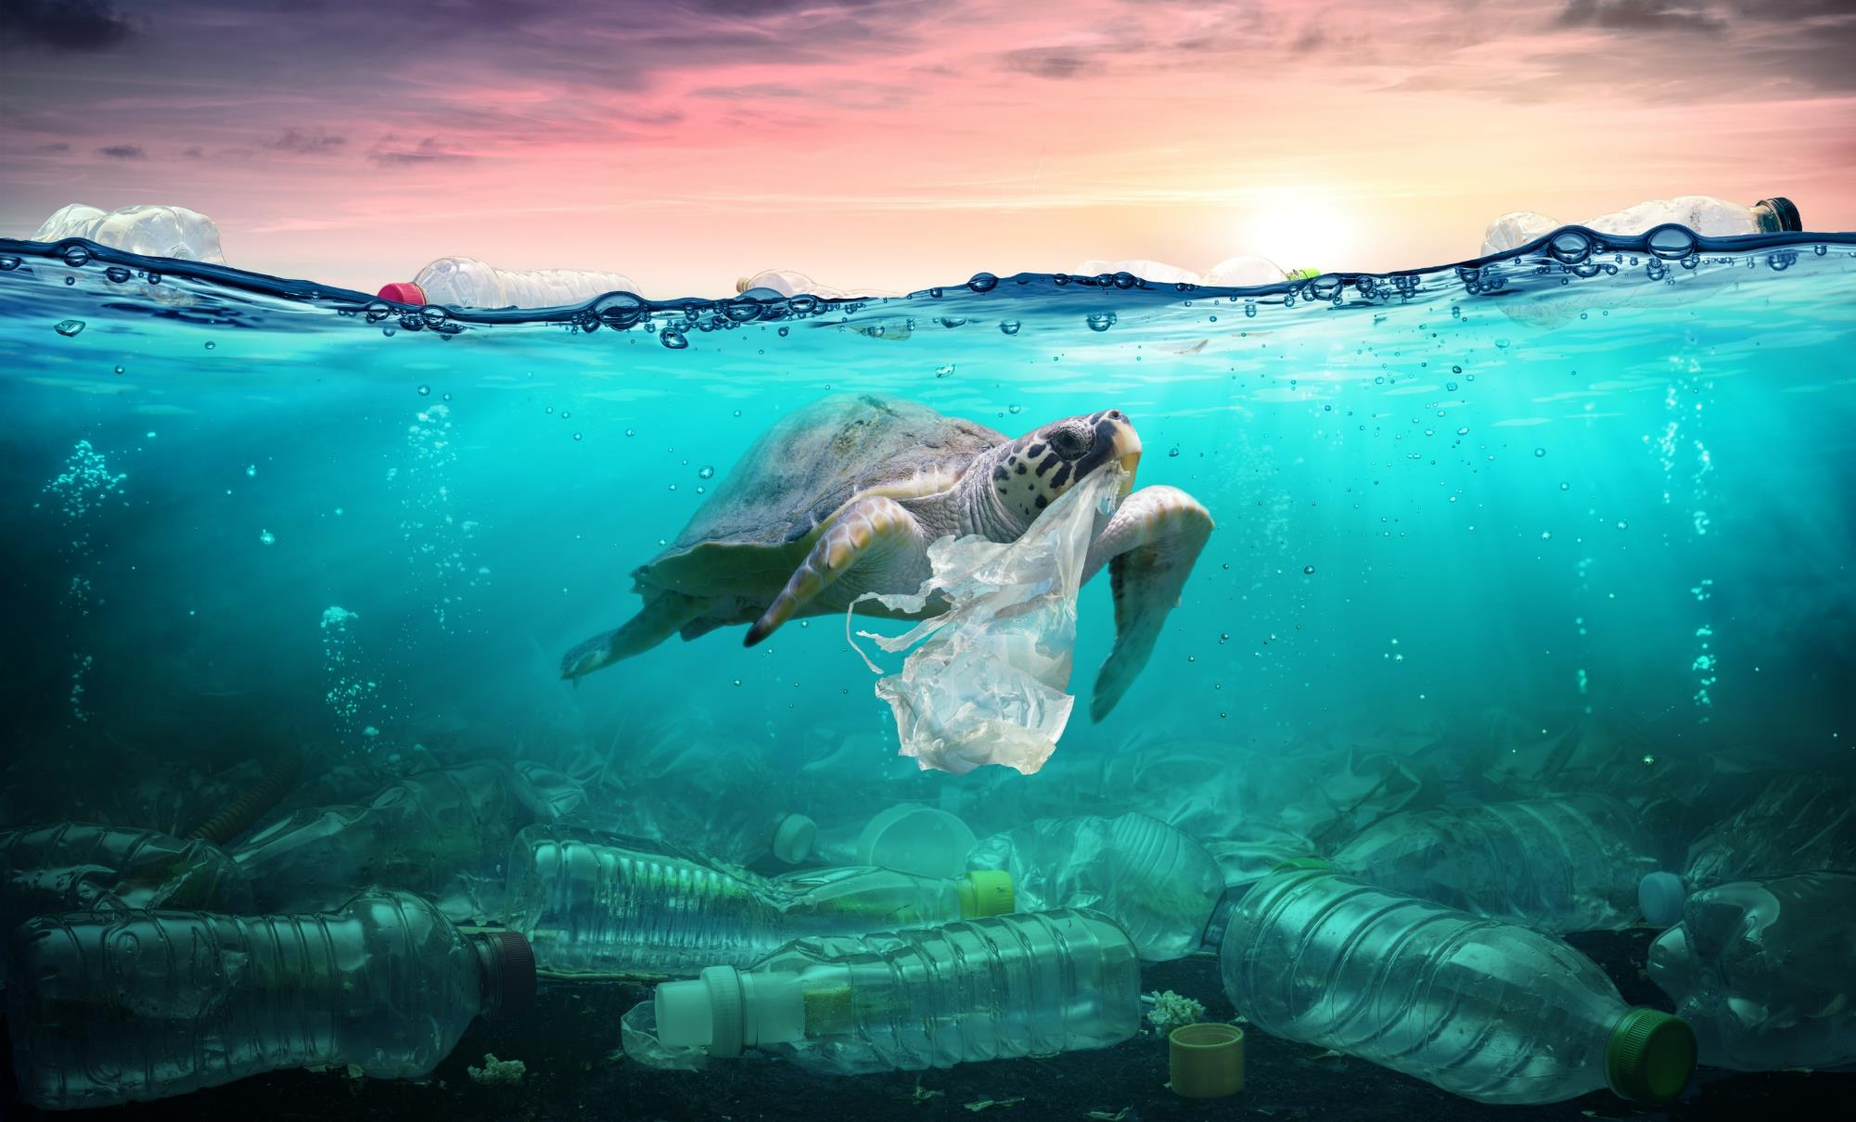
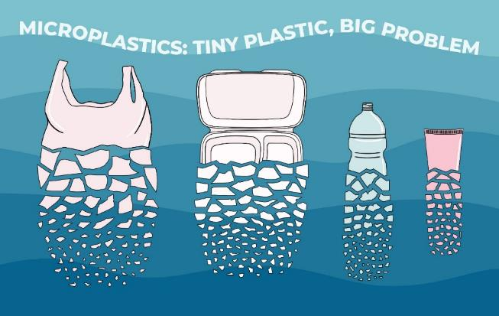
Plastic waste is killing our oceans.
Plastic
breaks down into tiny fragments called microplastics.
If we don’t act now, by 2050 there could be more plastic than fish.
Click to hear more from a scientist

Slide 4
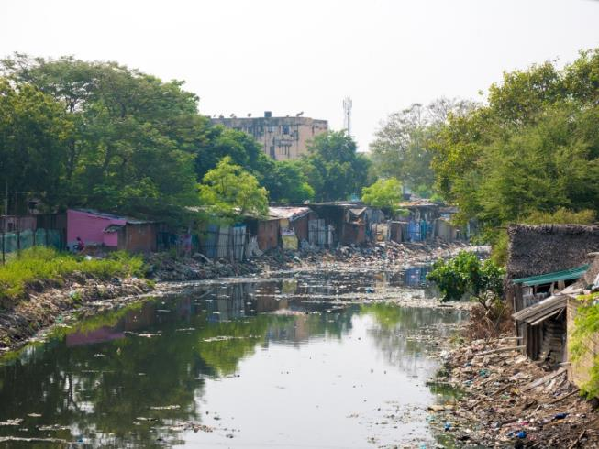
Scientists are worried about pollution from microplastics.
We know they harm sea animals, and they could be harming us.
Around 80% of the plastic in the ocean comes from the land.
It gets to the ocean from rivers.
Click to find out how we can solve the problem of microplastics

Slide 5
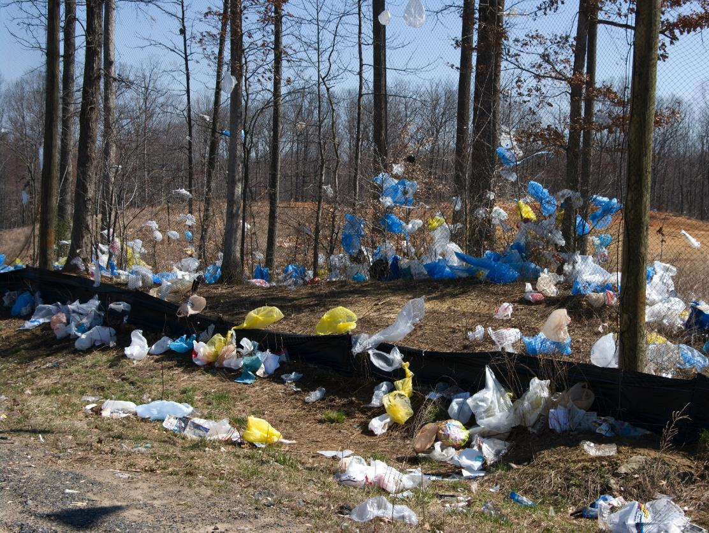
One solution to the problem is to stop littering the land.
How bad is plastic littering near you?
Why not find out and tell us!

Slide 6
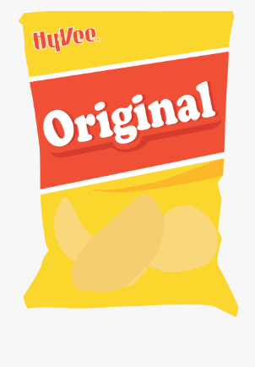

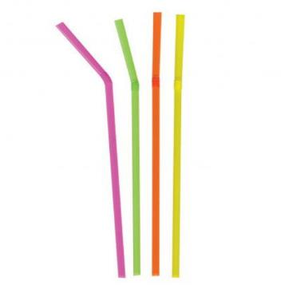
Some items are single-use plastics.
They are designed to be used once and then thrown away.

Slide 7



Plastics can be big or very small.
microplastics
macroplastics
skin cell
30 µm
amoeba
500 µm
football
20 cm
grain of rice
8 mm
mitochondrion
4 µm
1 µm
10 µm
100 µm
1 mm
1 cm
10 cm
1 m
µm is short for micrometre
1 µm = 0.001 mm
Each unit is 10 times (10x) bigger than the previous unit

Slide 8
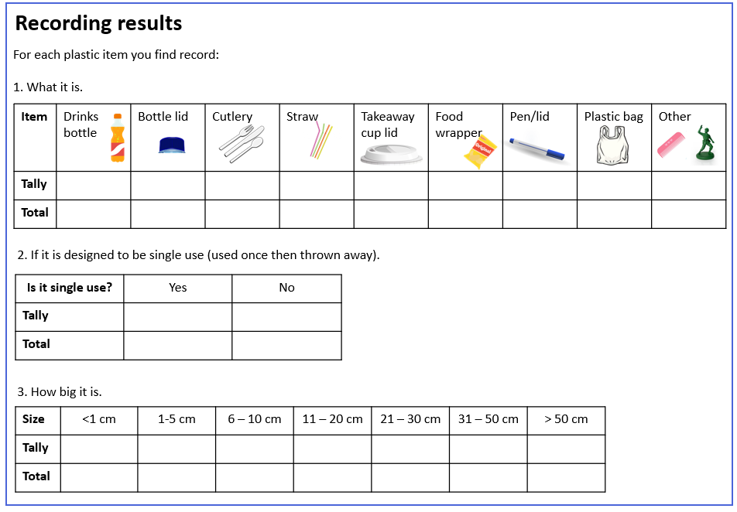
Carry out your litter hunt.
For each piece of plastic litter you find record:
What it is.
If it is single use.
How big it is.
Then put your results together for a class table.

Slide 9
Tell us what you found out!
You can include:
Your completed class table.
Photos of the largest and smallest plastic you found.
A message to people on why they should care about plastic pollution.
Click to share

Slide 10
