Slide 1
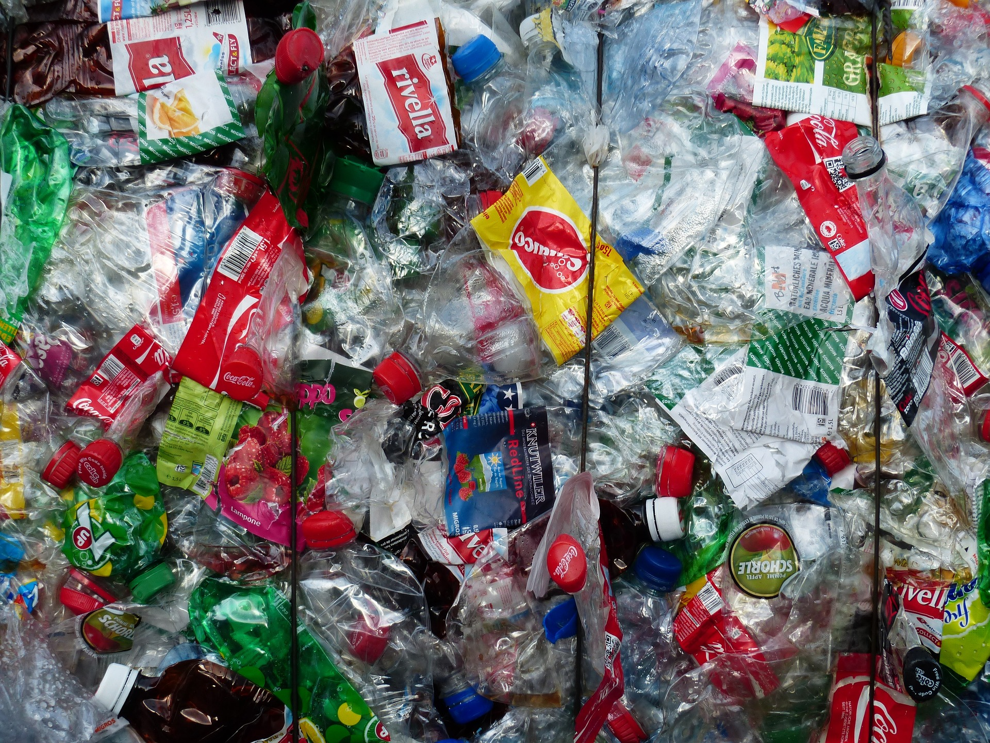
The Great Big Litter Hunt
Student sheet

Slide 2
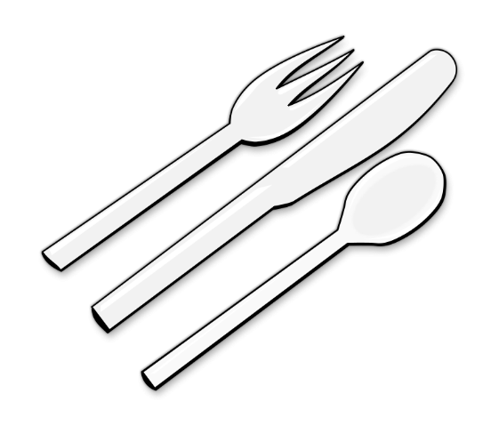
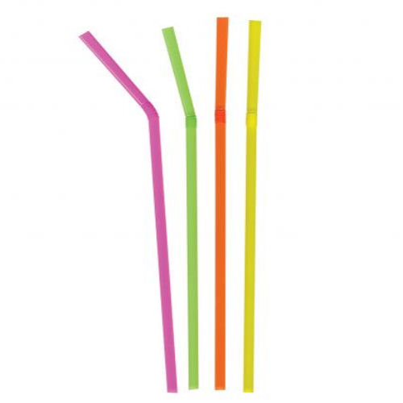
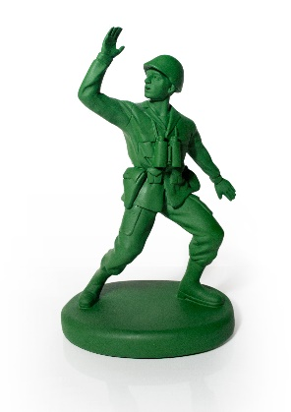
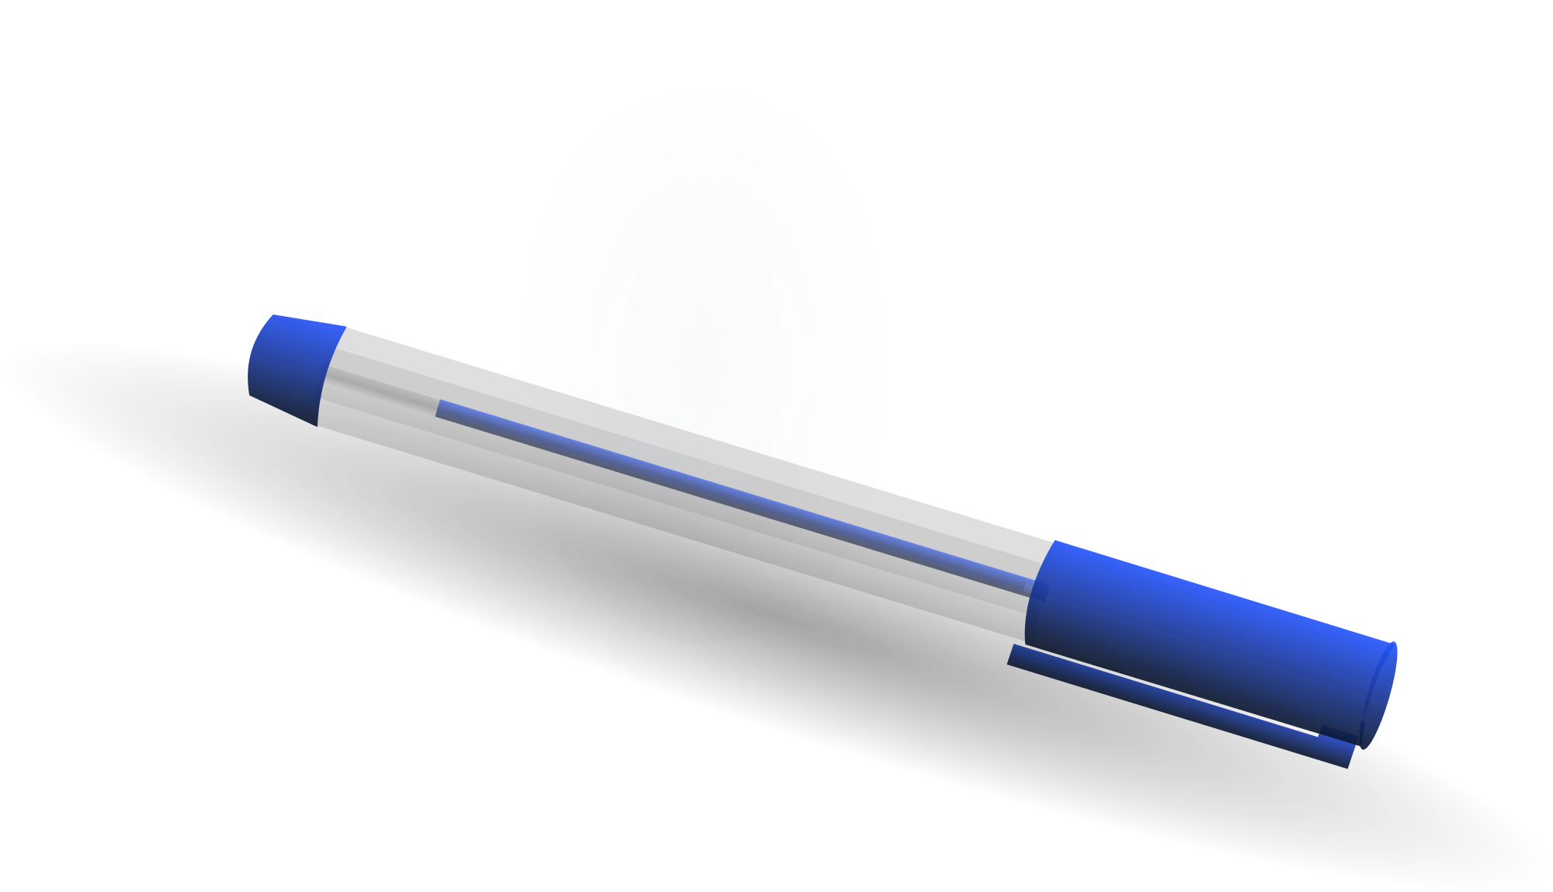
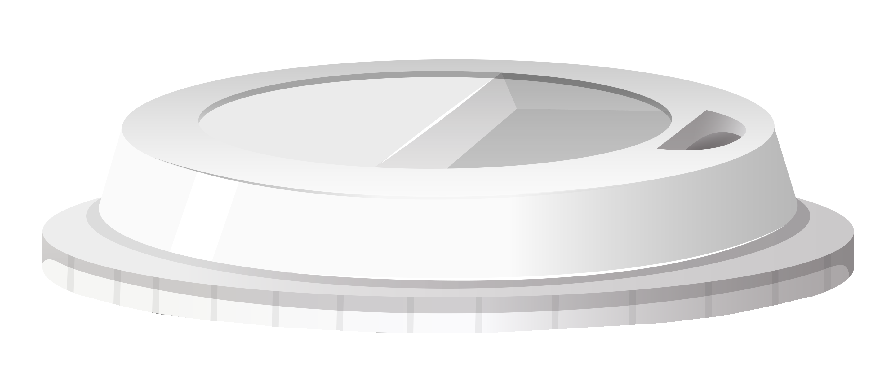
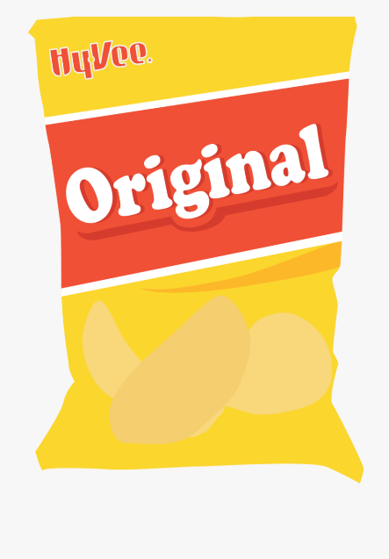
Recording results
For each plastic item you find record:
1. What it is.
Item | Drinks bottle | Bottle lid | Cutlery | Straw | Takeaway cup lid | Food wrapper | Pen/lid | Plastic bag | Other
Tally
Total
2. If it is designed to be single use (used once then thrown away).
Is it single use? | Yes | No
Tally
Total
3. How big it is.
Size | <1 cm | 1-5 cm | 6 – 10 cm | 11 – 20 cm | 21 – 30 cm | 31 – 50 cm | > 50 cm
Tally
Total

